Slide 1
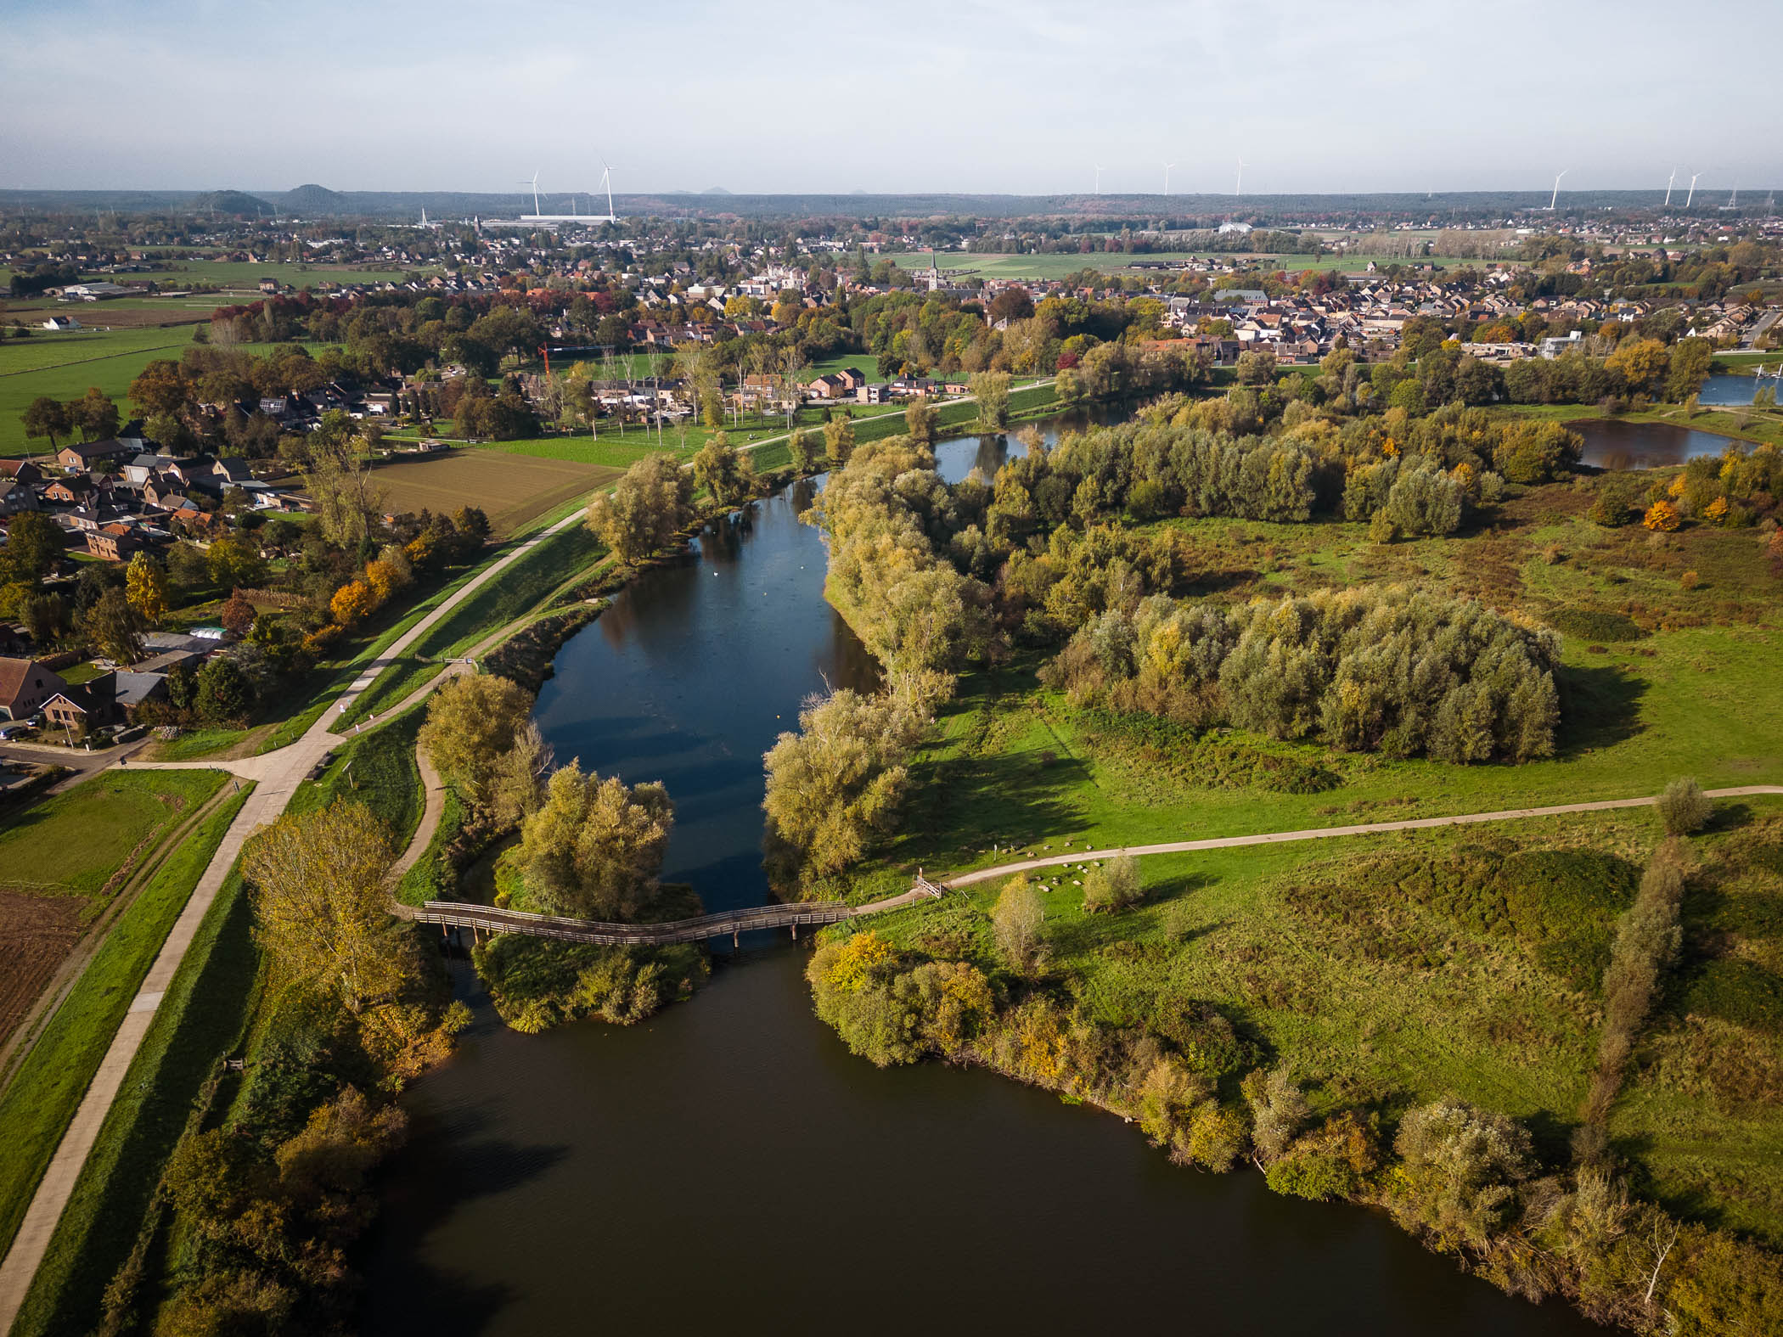



Flanders’ Blue Deal
into action

Slide 2
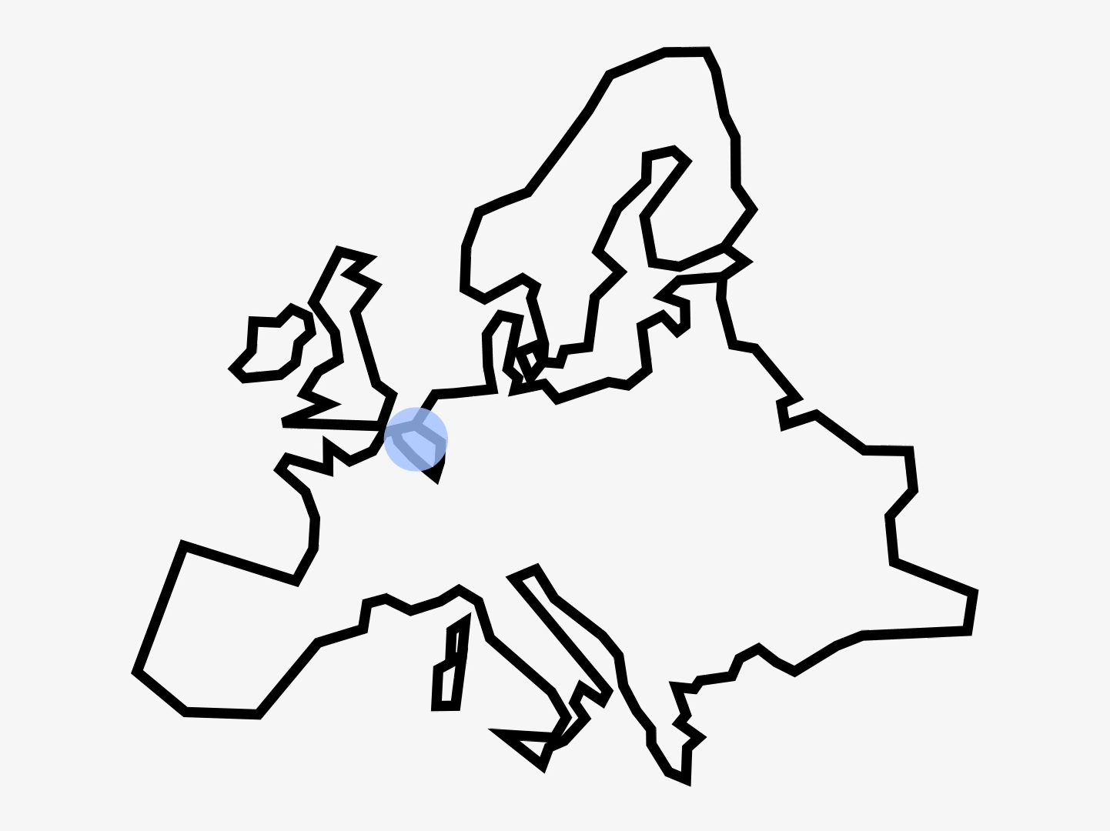

Flanders
(Belgium)
7 million people living
in a small region
with a vibrant economy and little resources
in the heart of Europe.

Slide 3
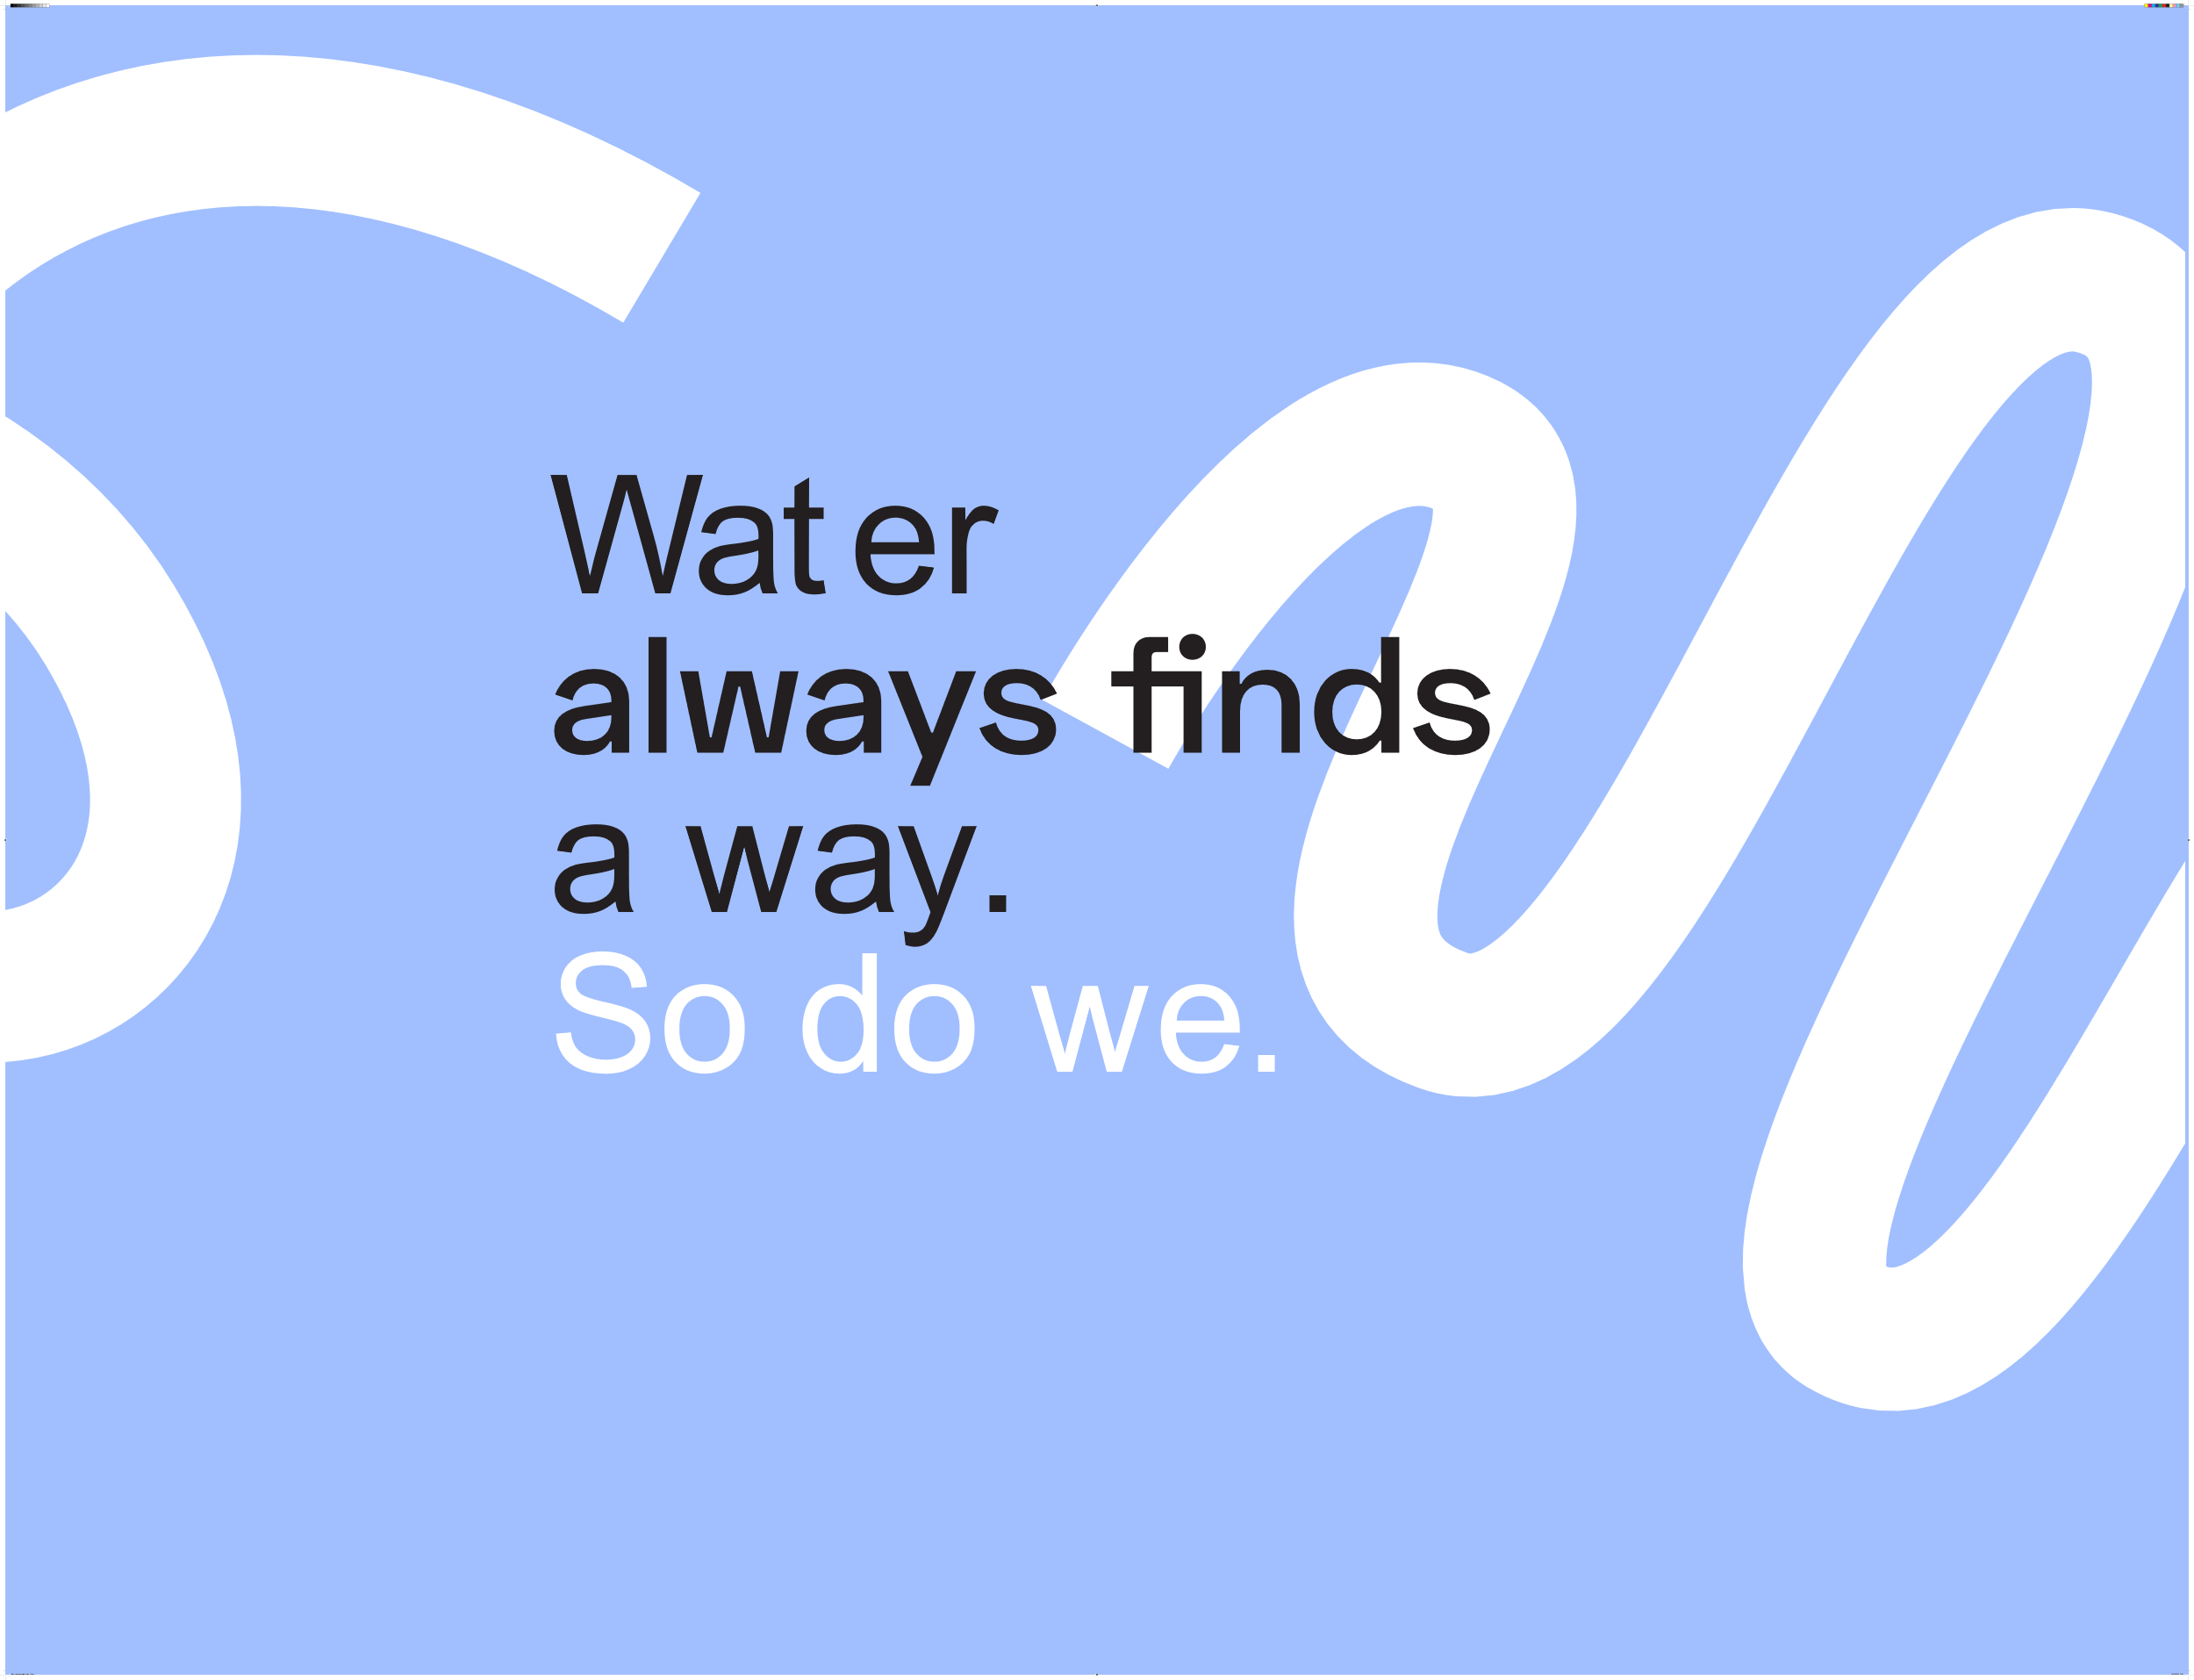

Water vindt altijd een weg, hoe uitdagend de omstandigheden ook.

Slide 4


Our approach is simple.
As Flemish water professionals…
We are like water.
We work like water.
We are fluid.
We work fluid.

Slide 5
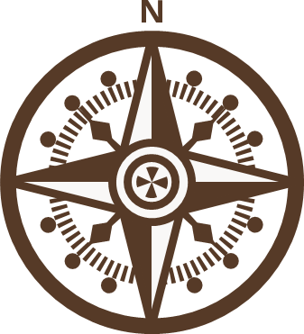

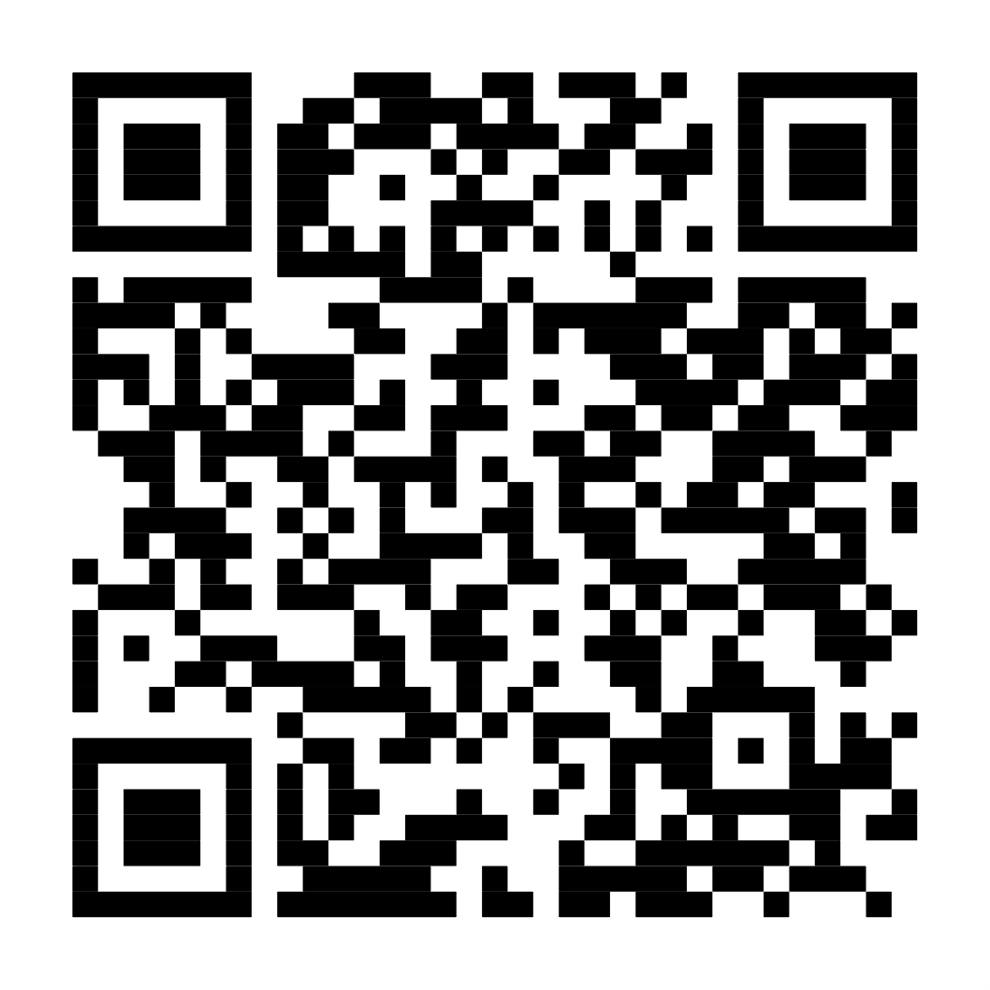
Our compass for a water resilient Flanders
The Blue Deal
Moving beyond sector-oriented policies and investments to integrated, systemic and solution-oriented approach.
Read more

Slide 6
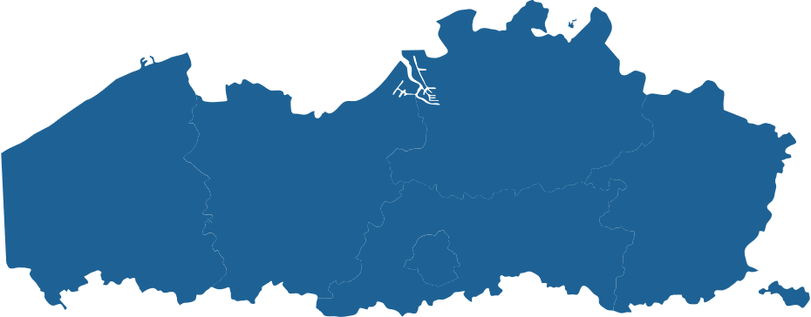

Regional coalitions (living labs)
The core of the Blue Deal solutions
Aligning strategic water goals with local needs and ensuring shared ownership.
Port of Antwerp-Bruges
WaterClimateHub
Kempen area
Business parks
Circular rain
City of Mechelen
Direct potable reuse
Herk & Mombeek

Slide 7
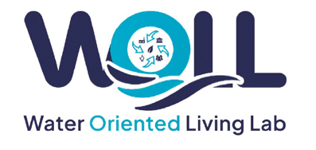
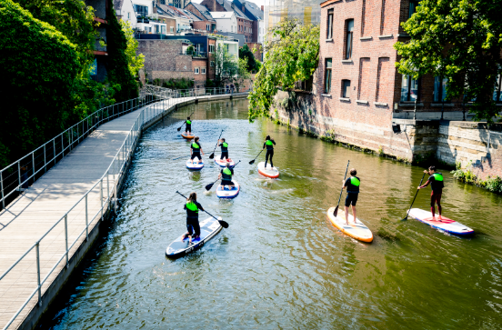
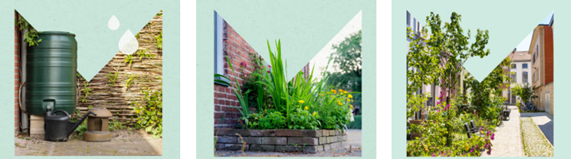
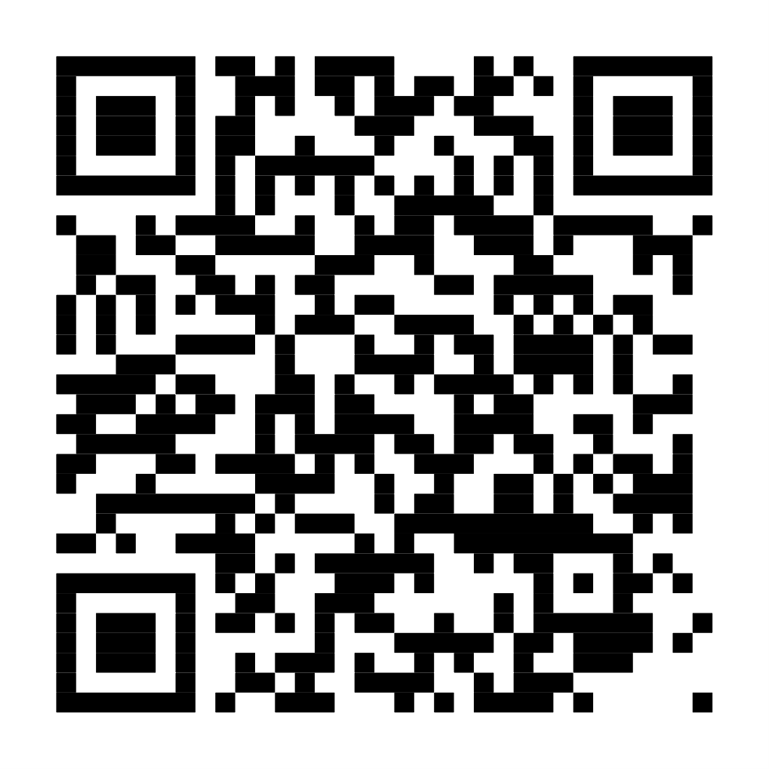
City of Mechelen
Citizen centric transition.
Giving space to nature and water in the city, climate adaptive streets.
“Resilience grows when citizens help build measures”
Read more

Slide 8
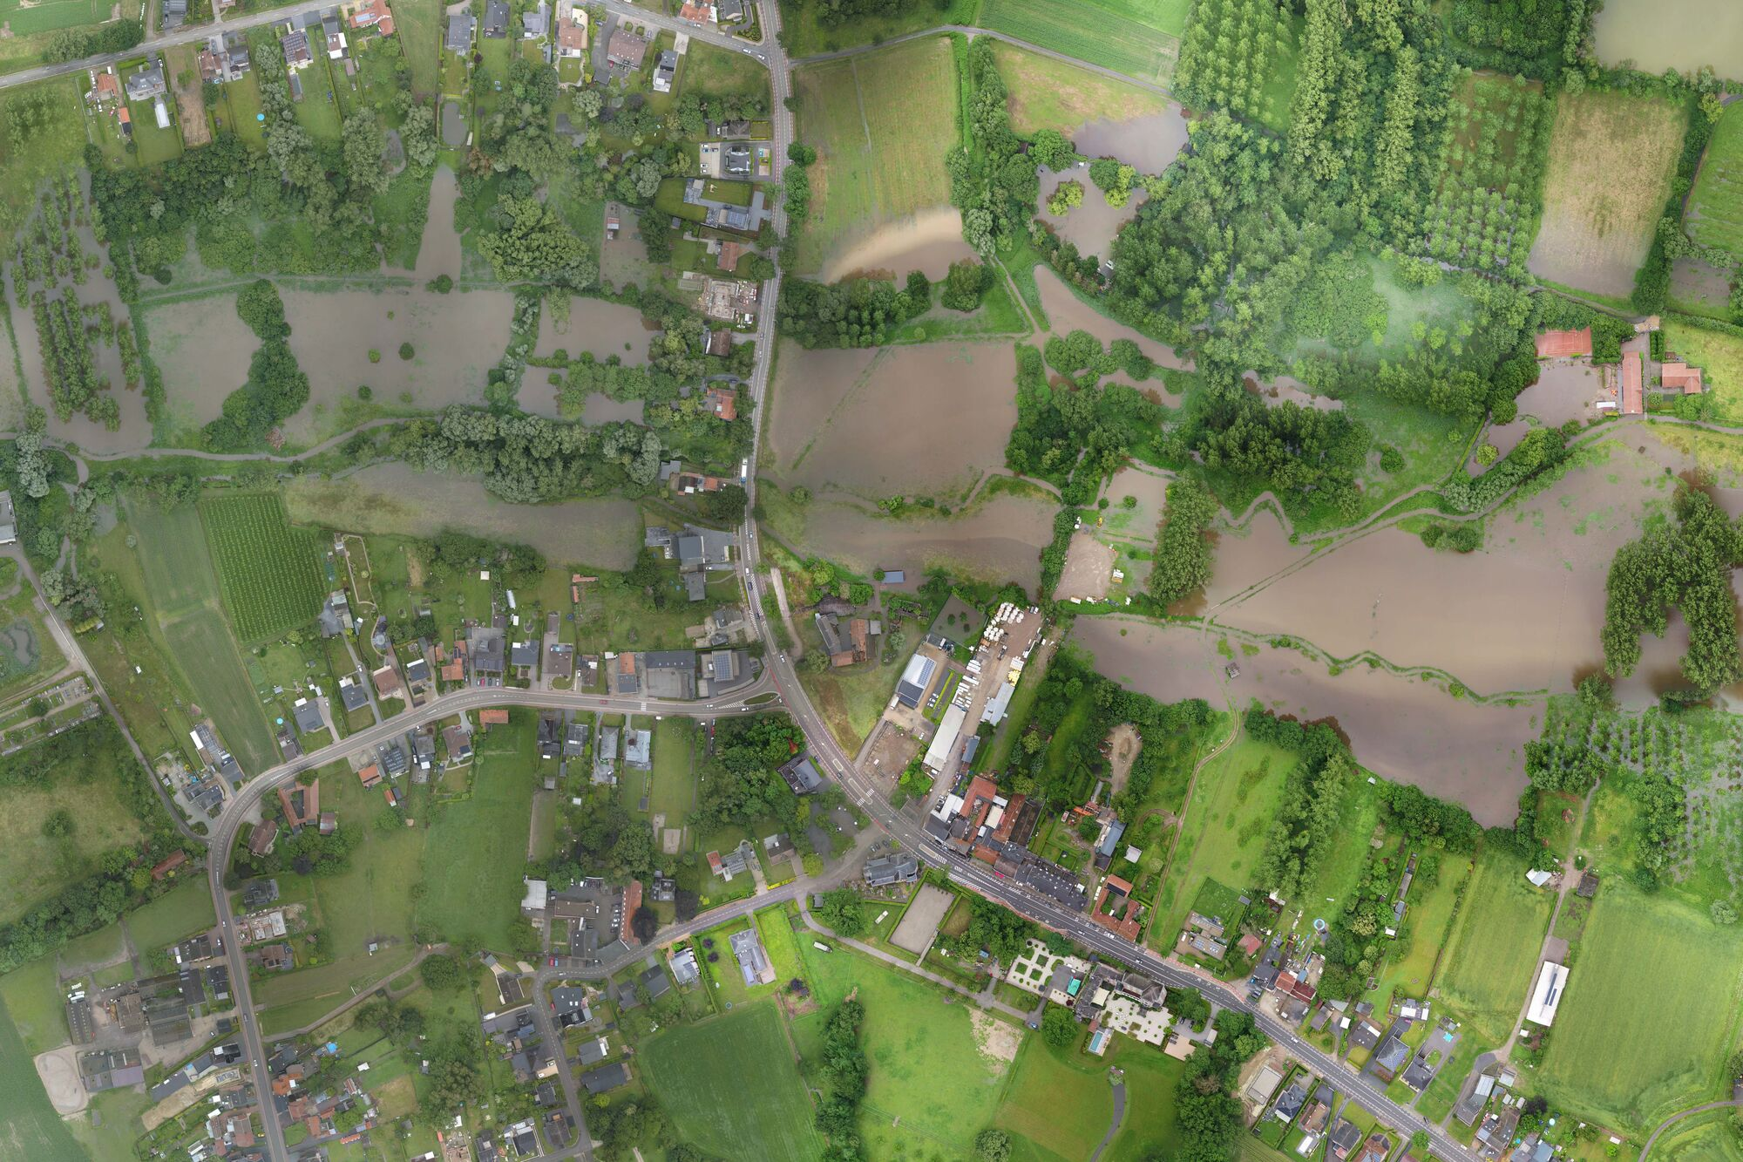
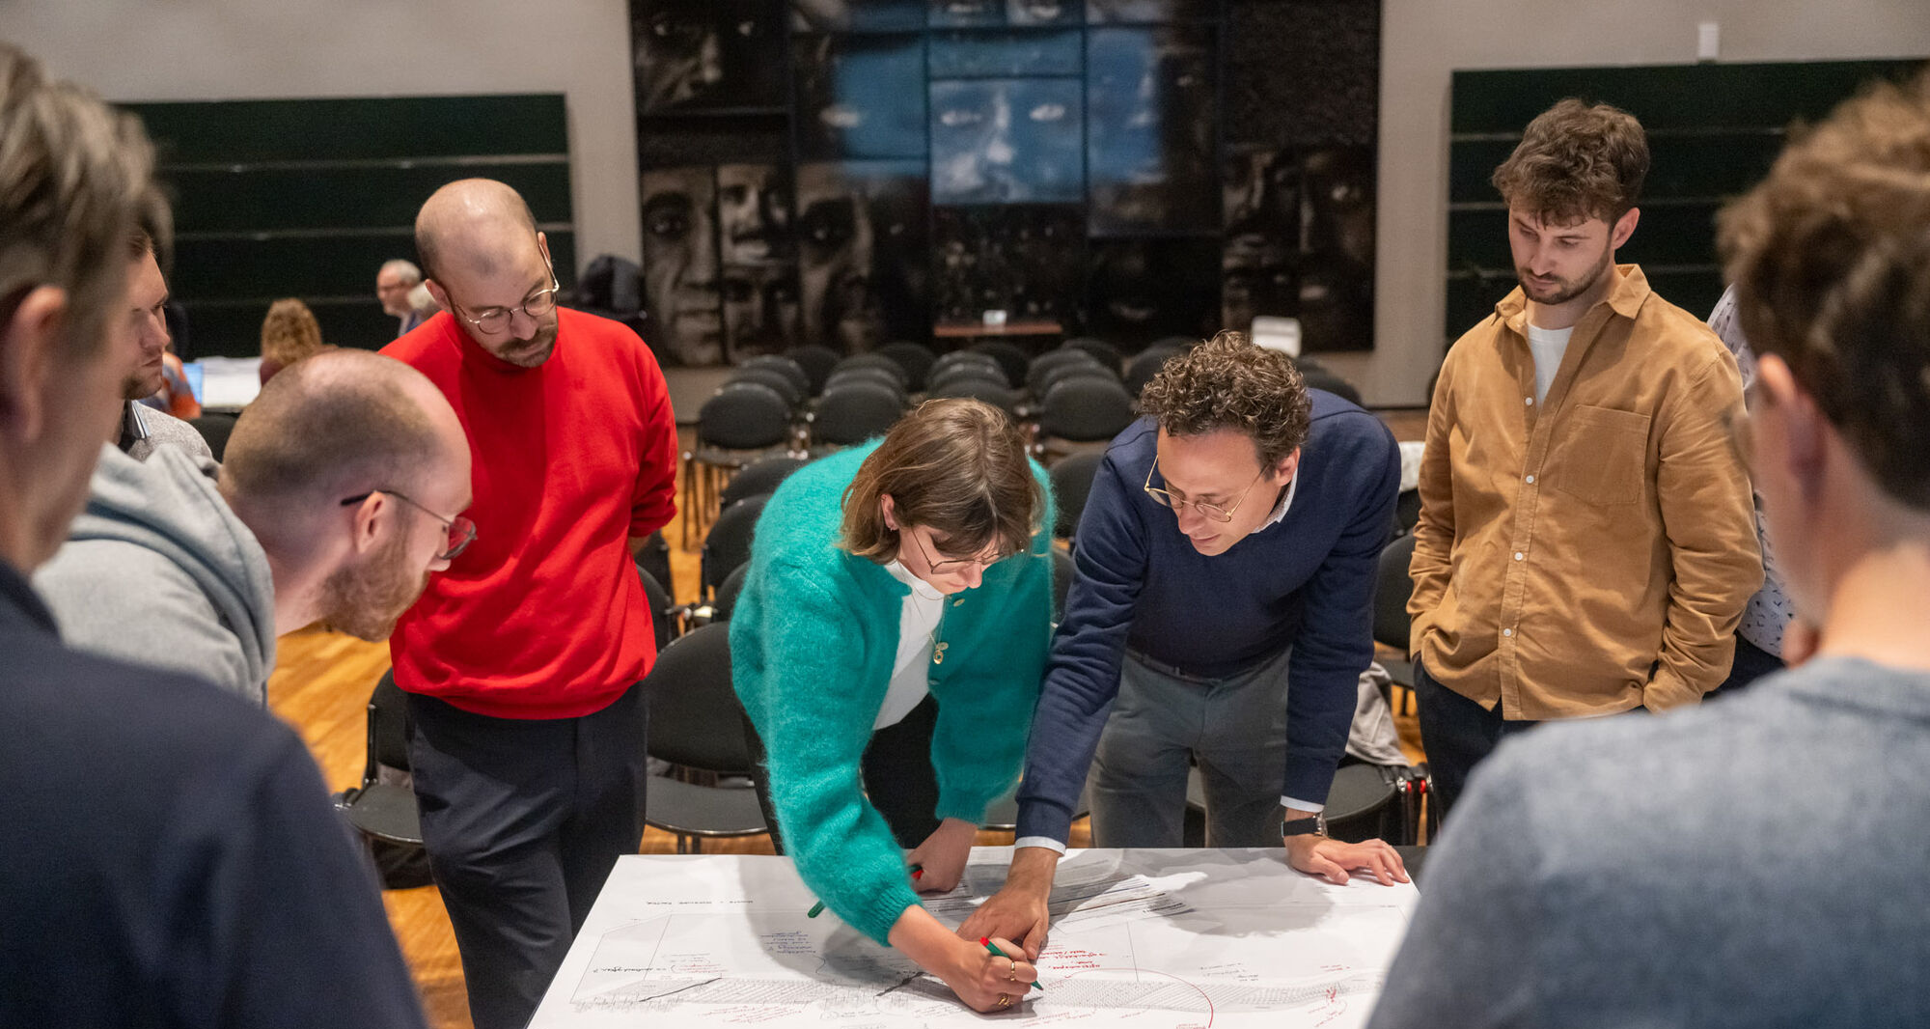
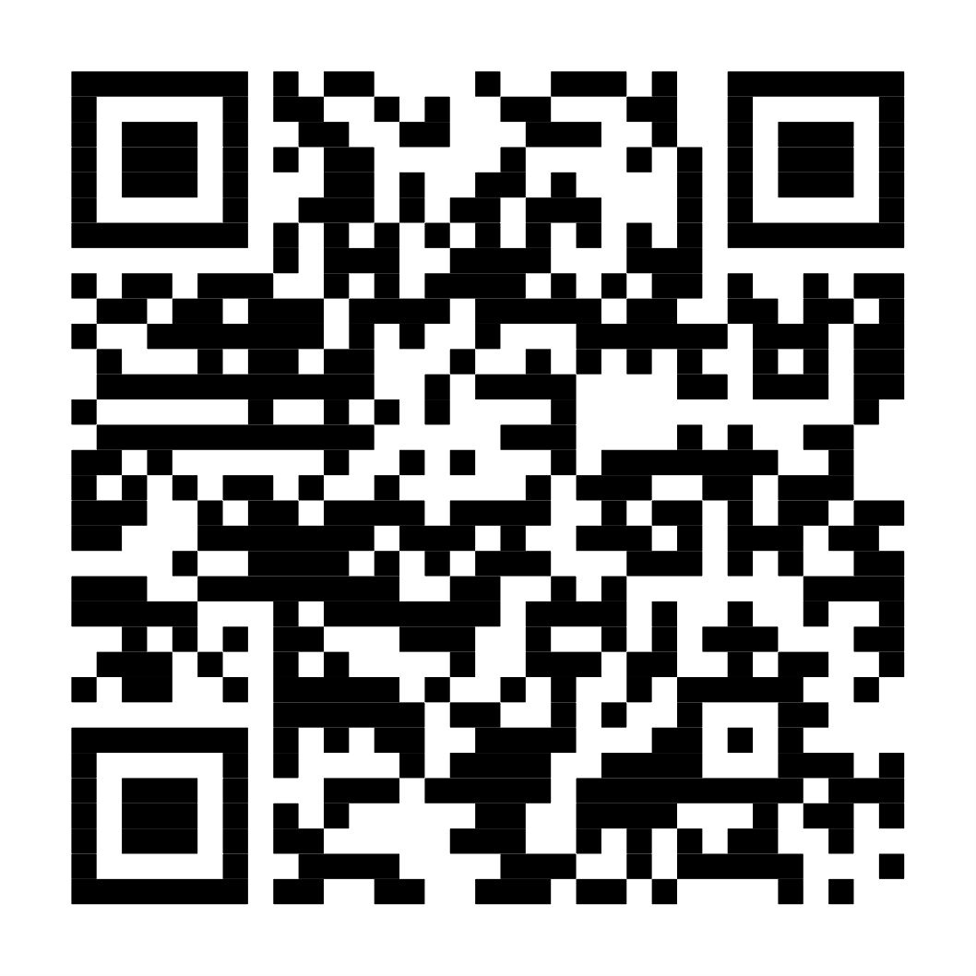
Herk and Mombeek: Sponge landscape
River and wetland restoration to strengthen the landscape’s sponge function
“Resilience starts by acting where the drop falls.”
Read more
Notes:
Living Lab Herk & Mombeek – Projects – Architecture Workroom Brussels

Slide 9
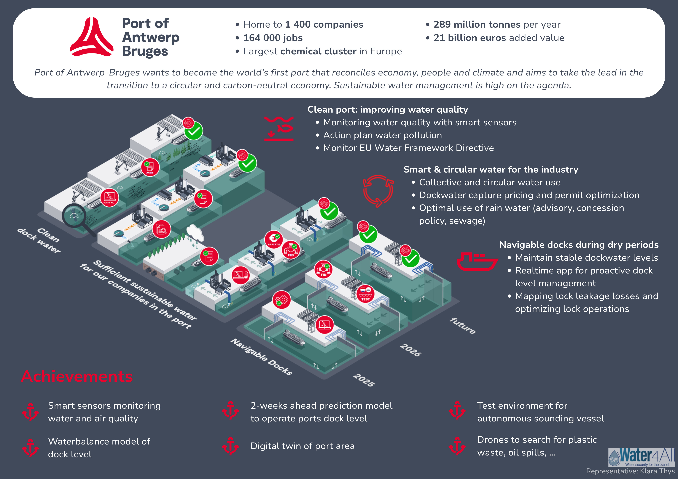
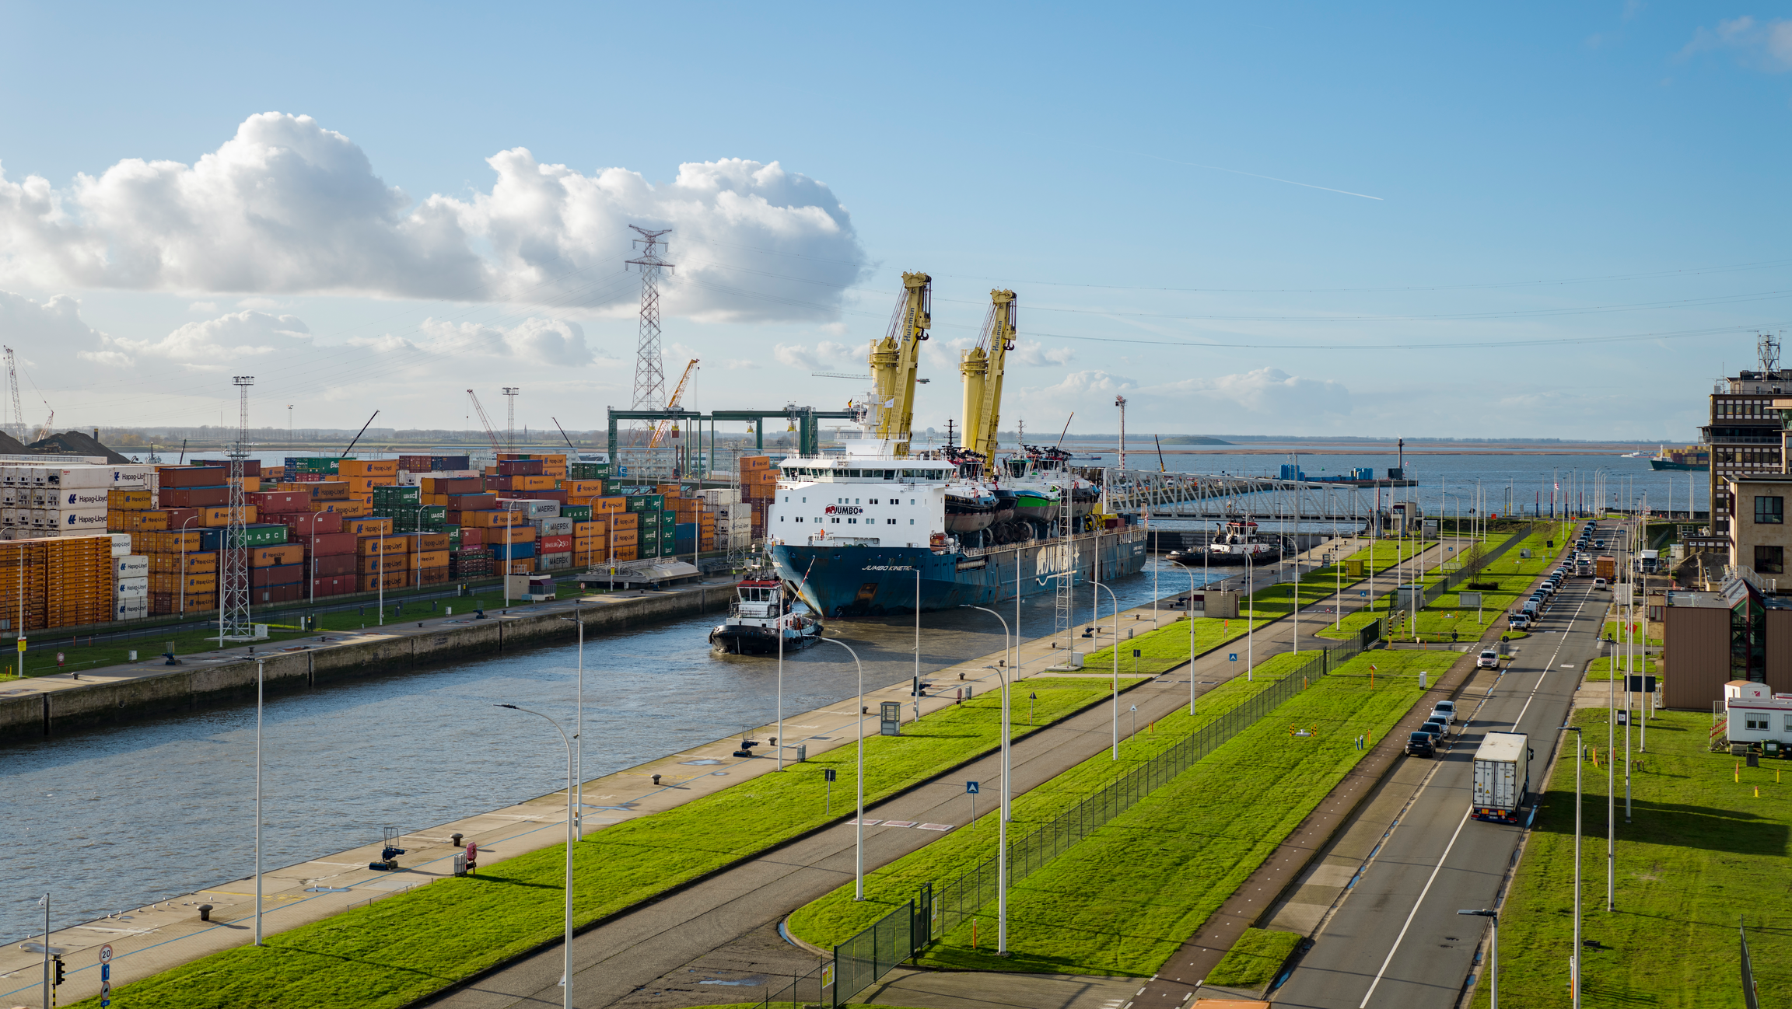
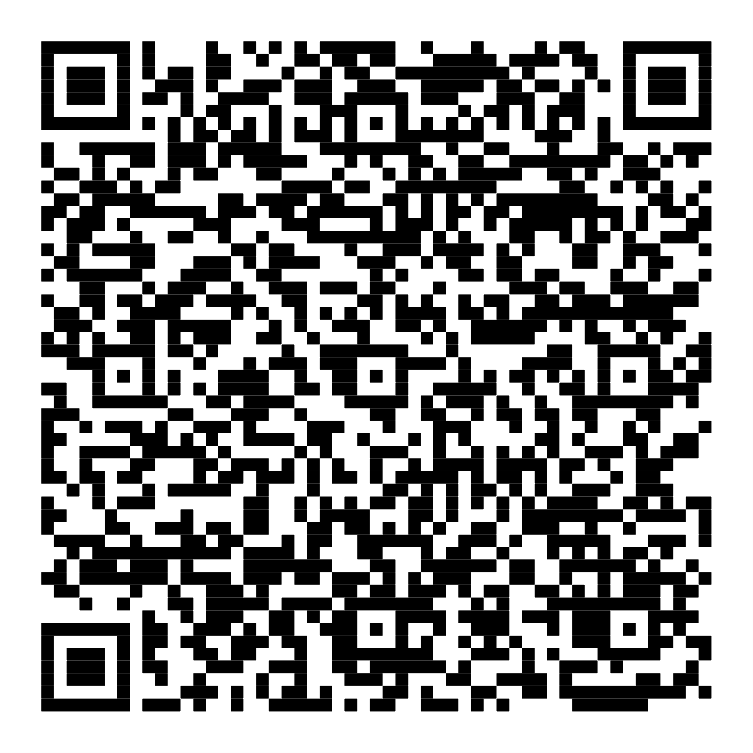
Water resilient ports
Strategic plan and collective actions for smart and circular water in port area.
“Resilience in the port starts when companies see water as a shared responsibility”
© PoAB
Read more

Slide 10
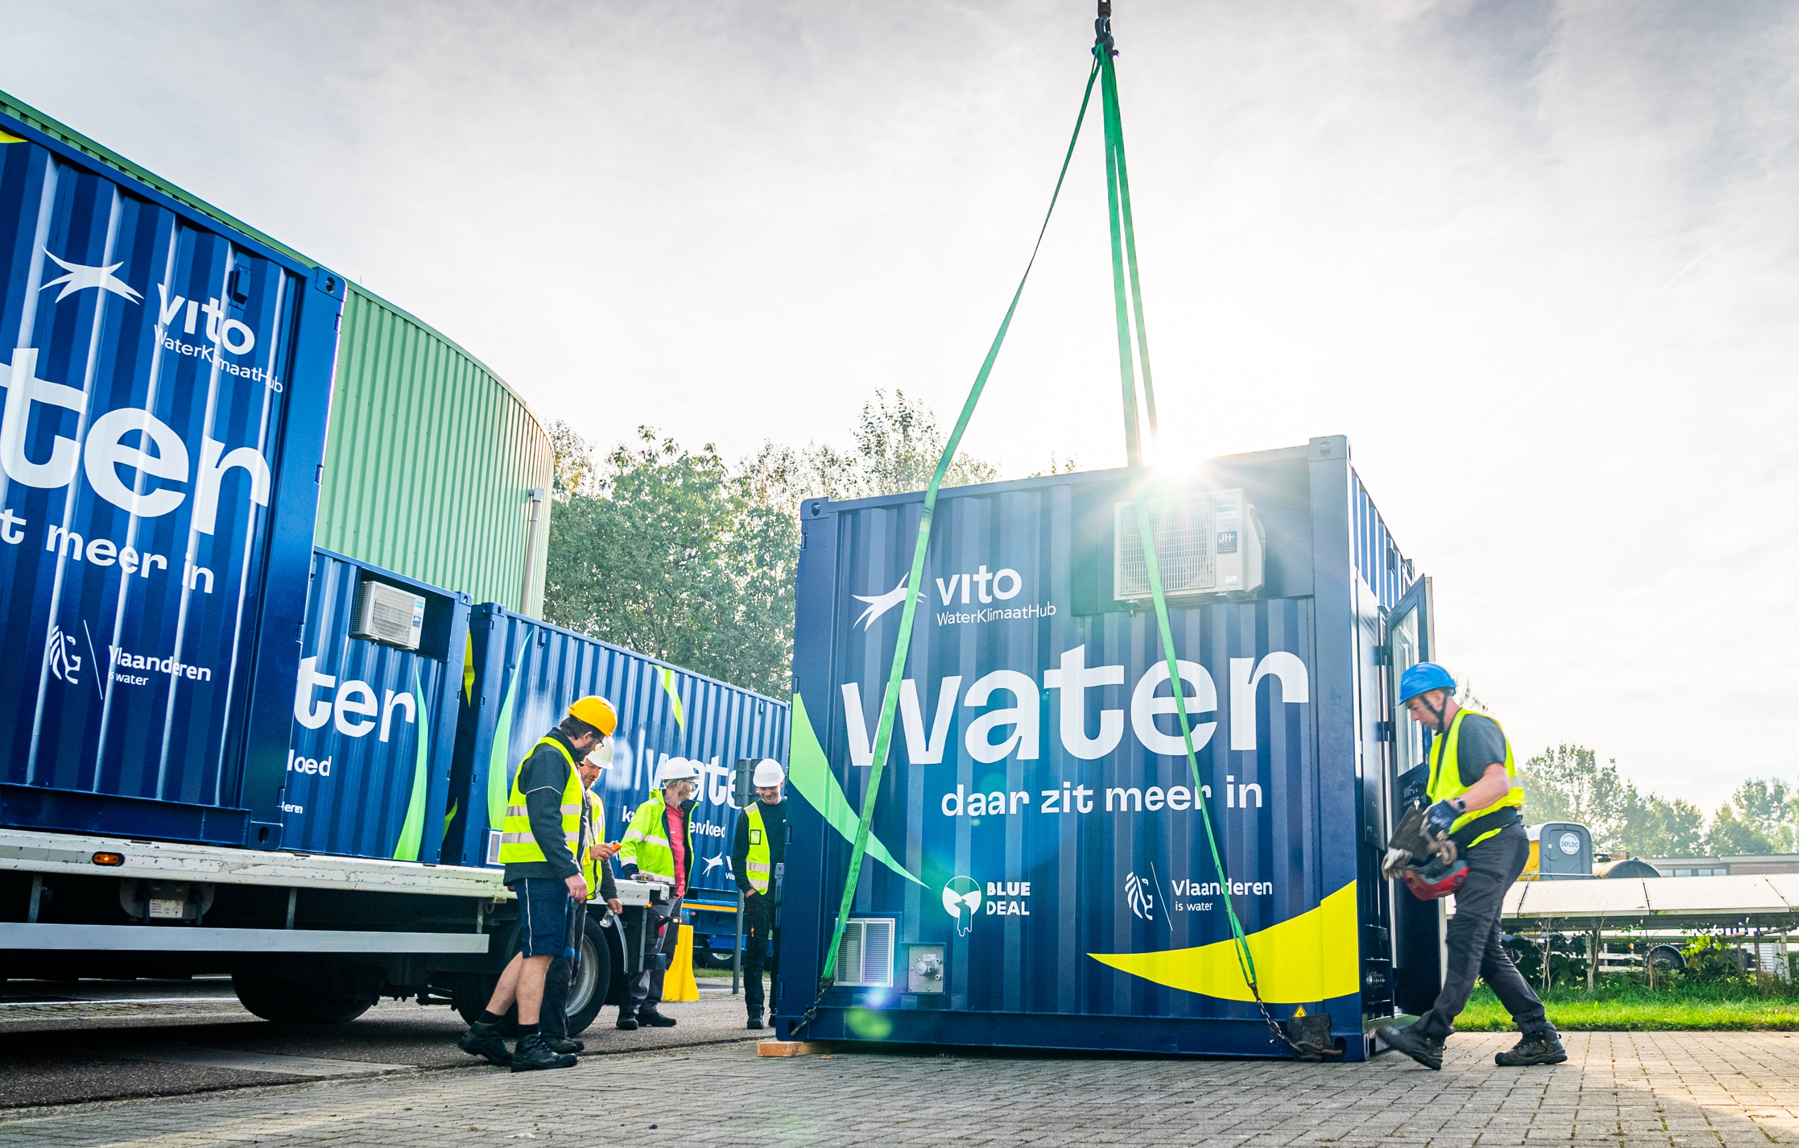
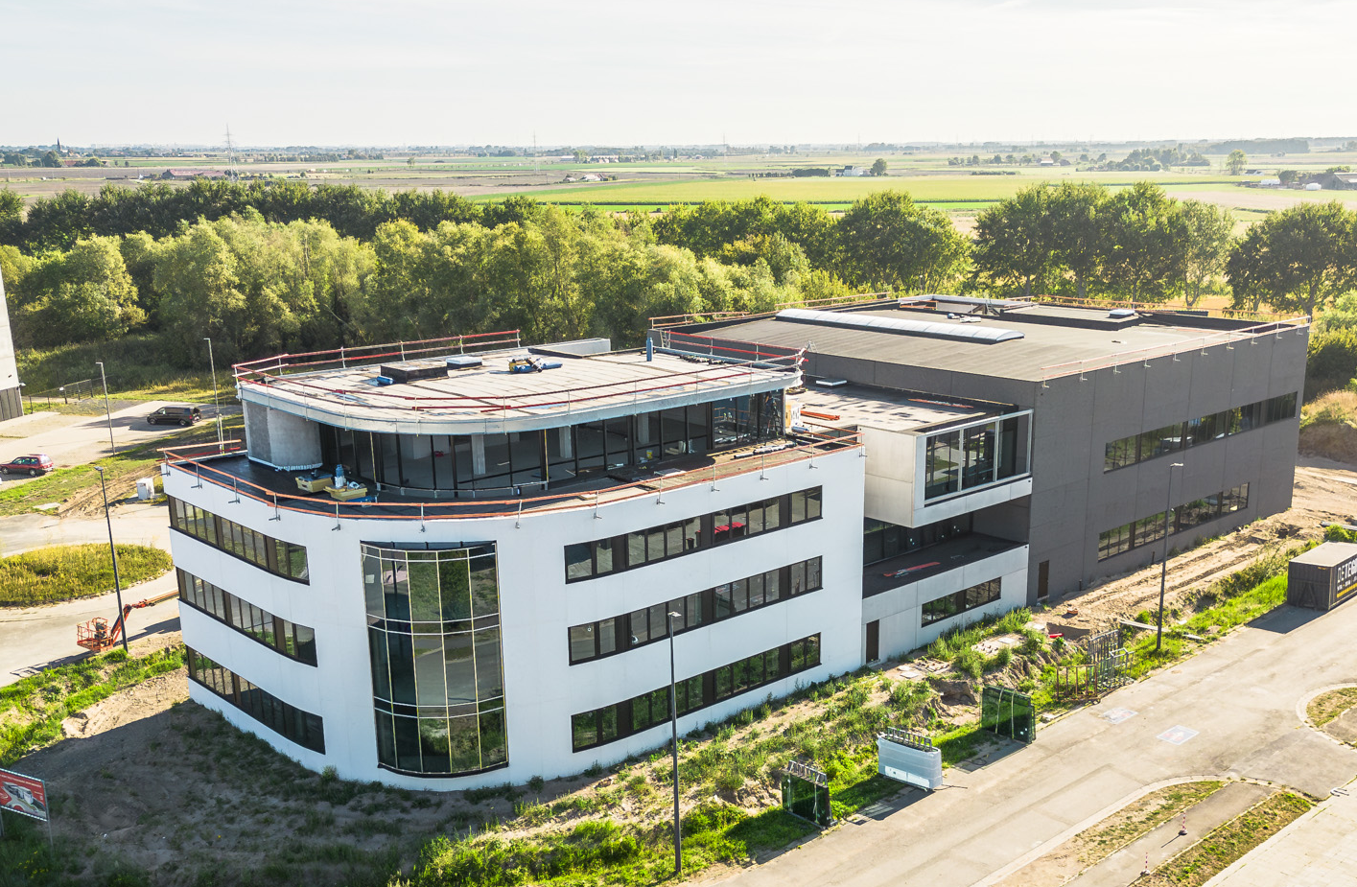
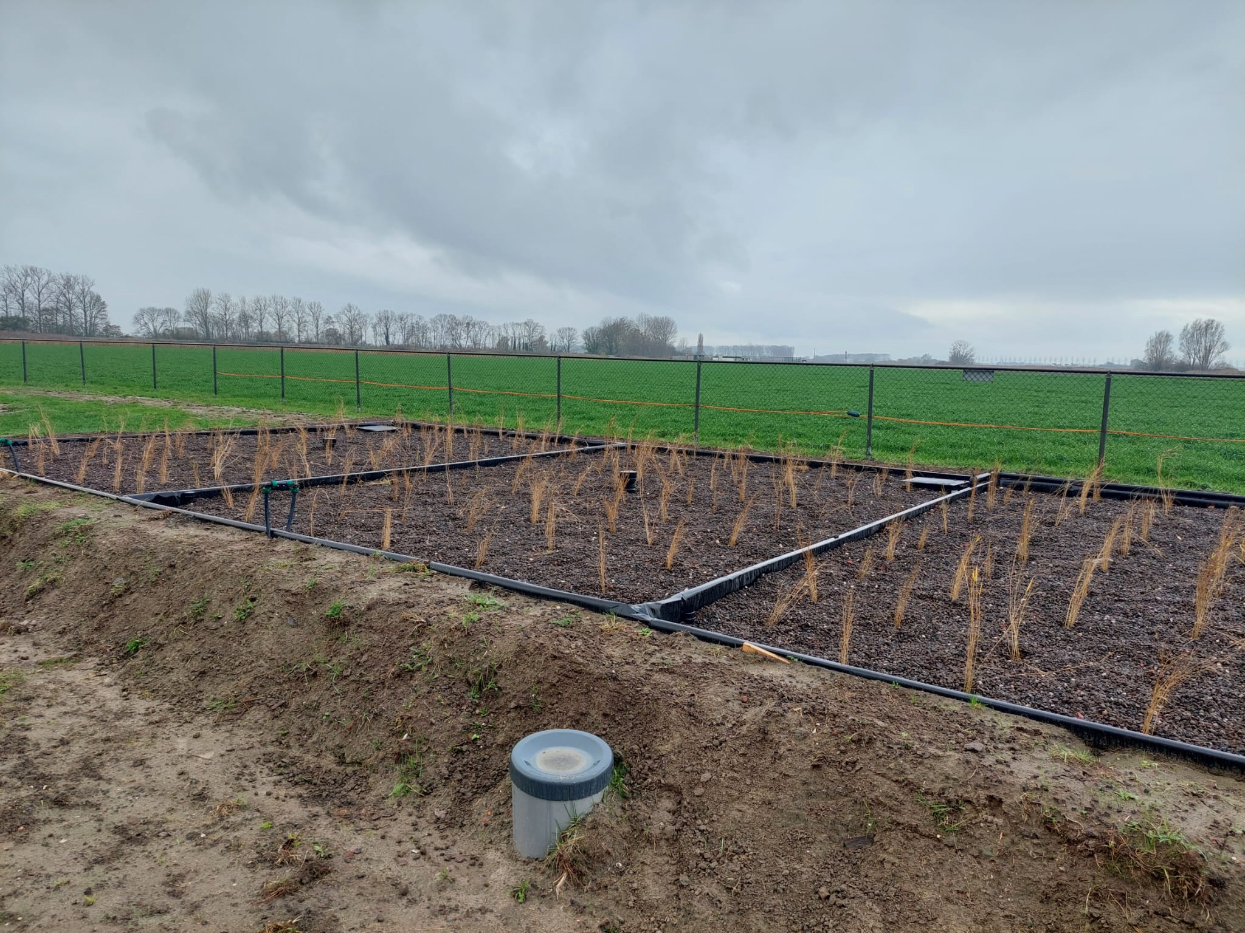
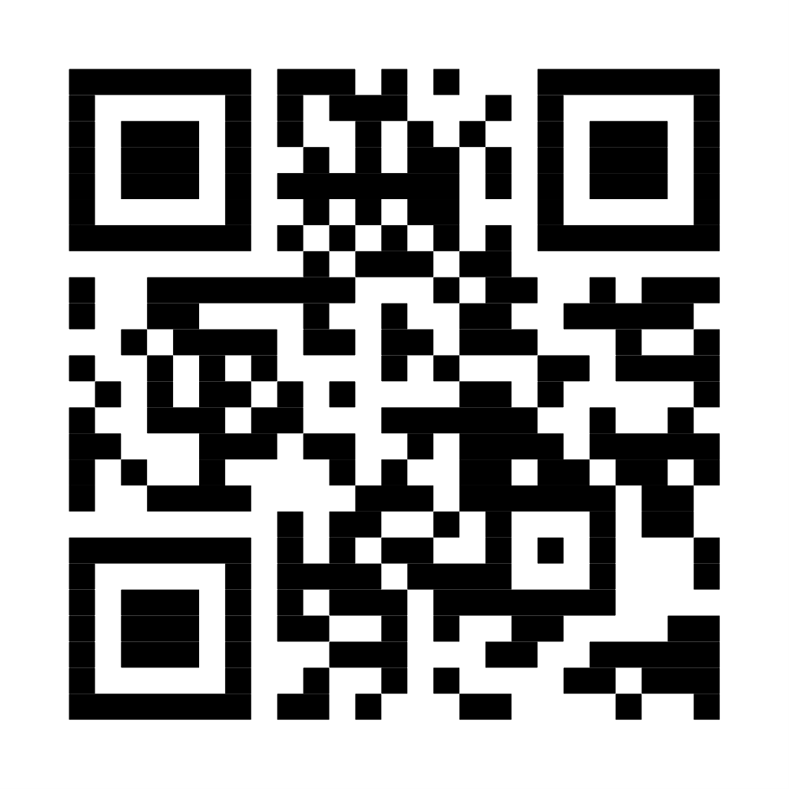
WaterClimateHub
Strengthen innovation to decouple water challenges from economic growth.
“Resilience is engineered in ecosystems - where industry, science, and policy innovate together”
Read more

Slide 11
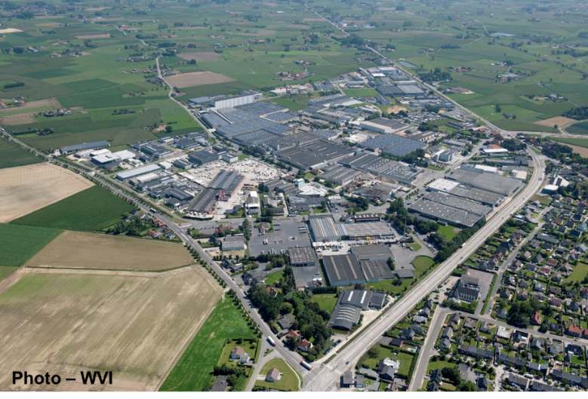

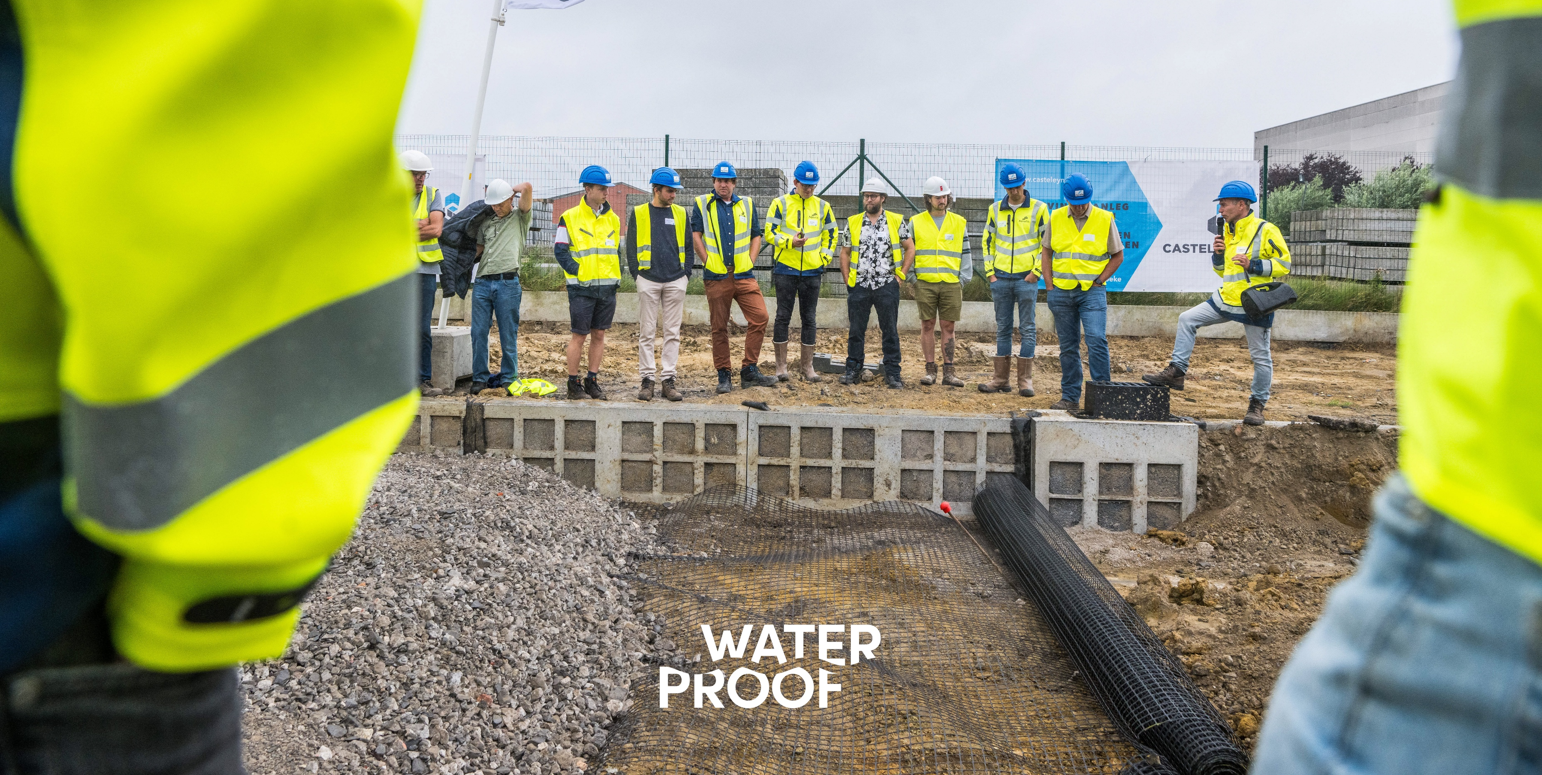
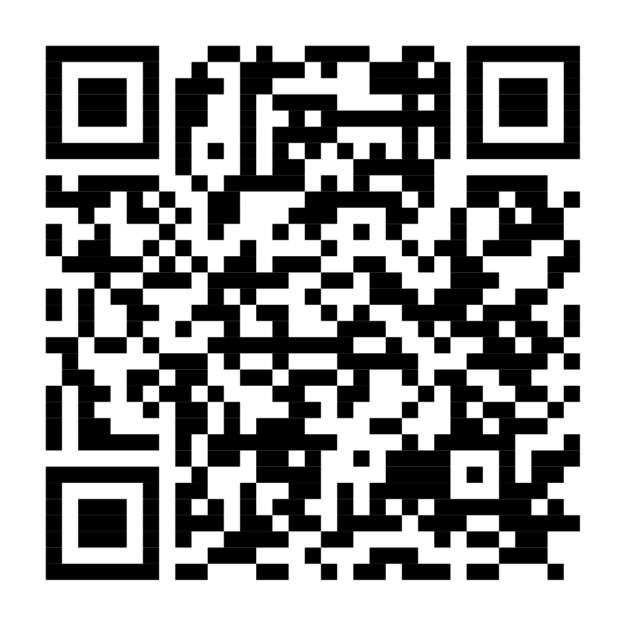
Climate adaptive business parks
Co-design and implementation of industrial reuse and buffering for agriculture.
Partnerships and business model innovation are key.
“Circular rain solutions safeguarding the business park’s water resilience”
Read more

Slide 12
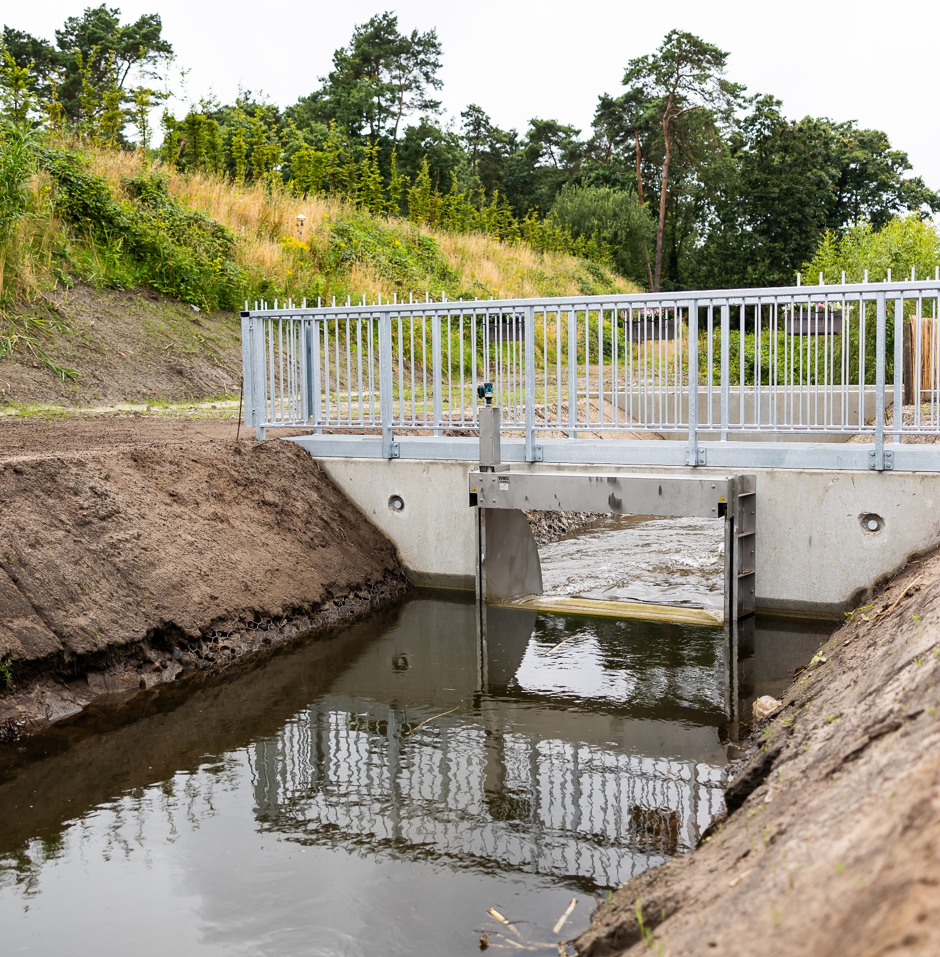
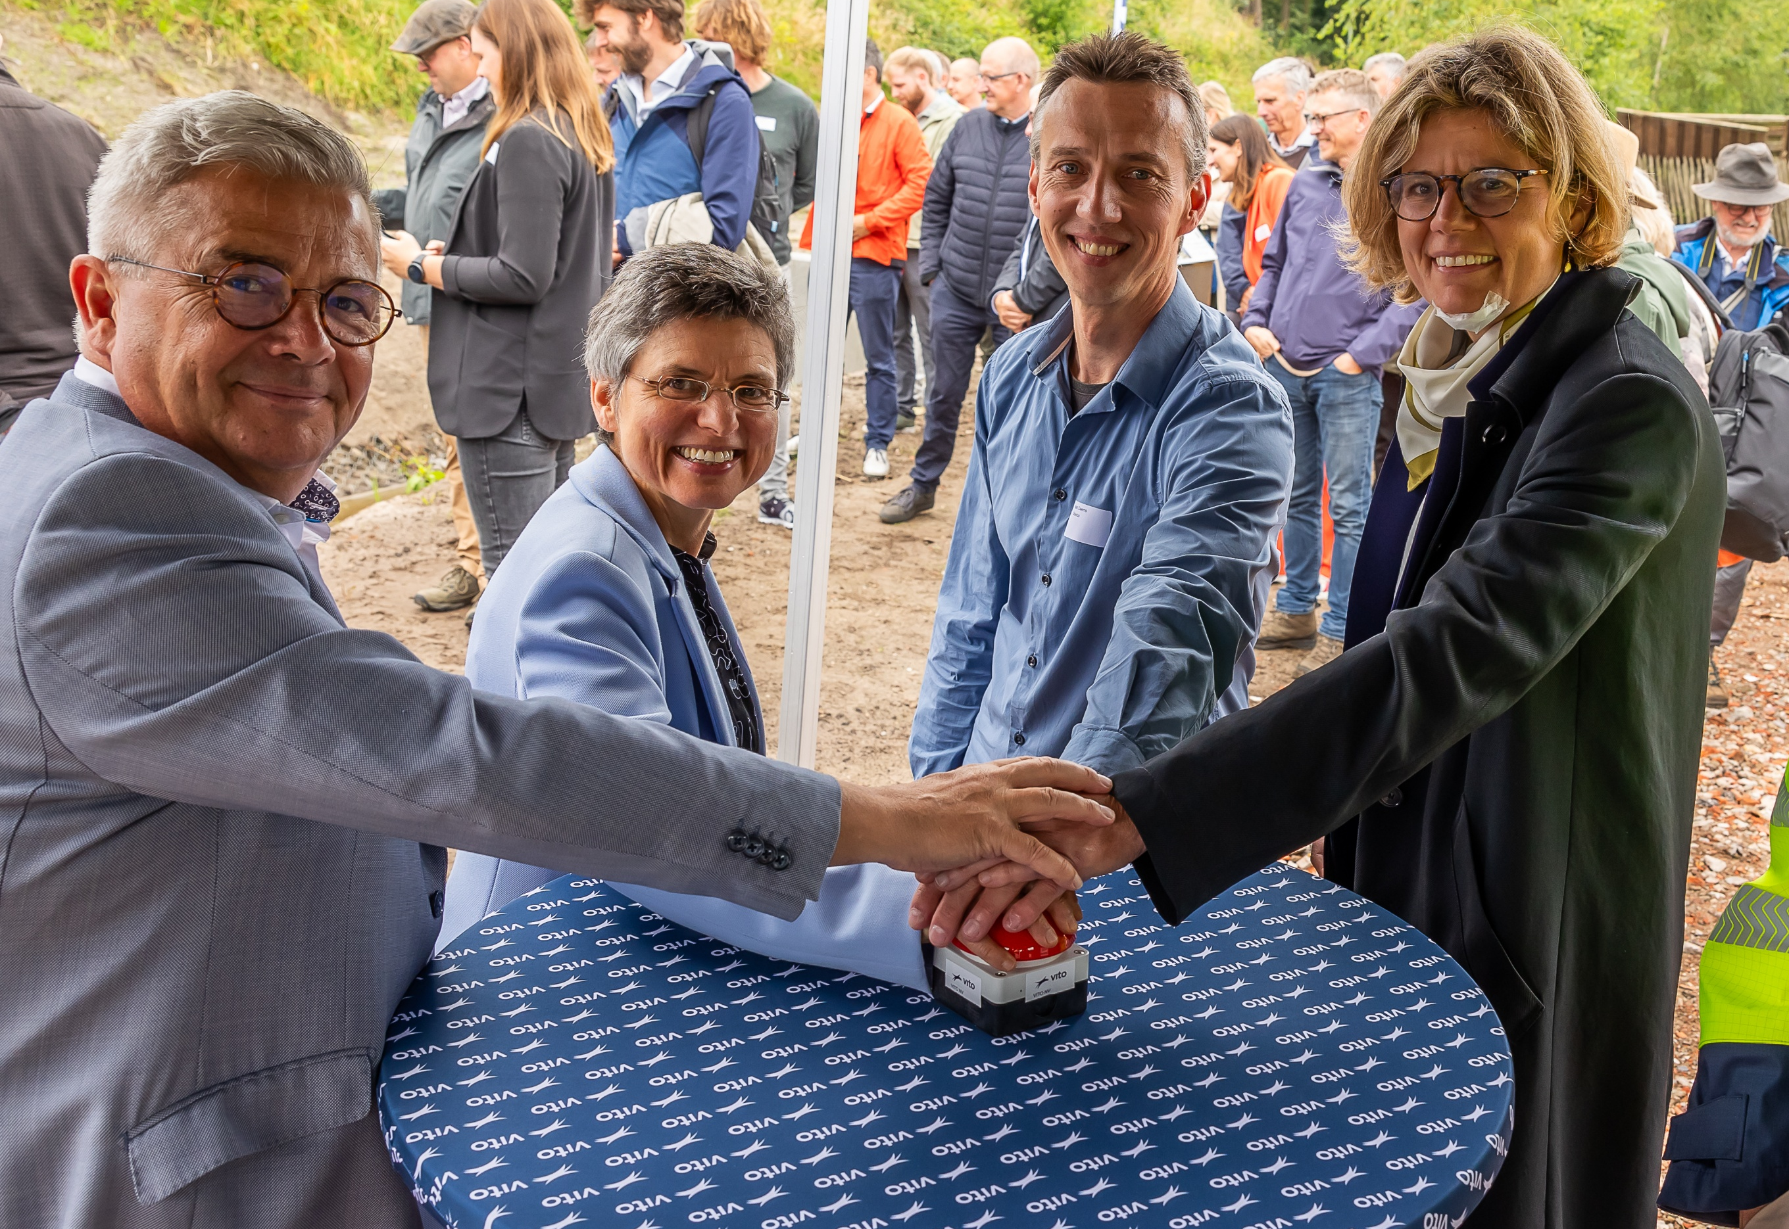
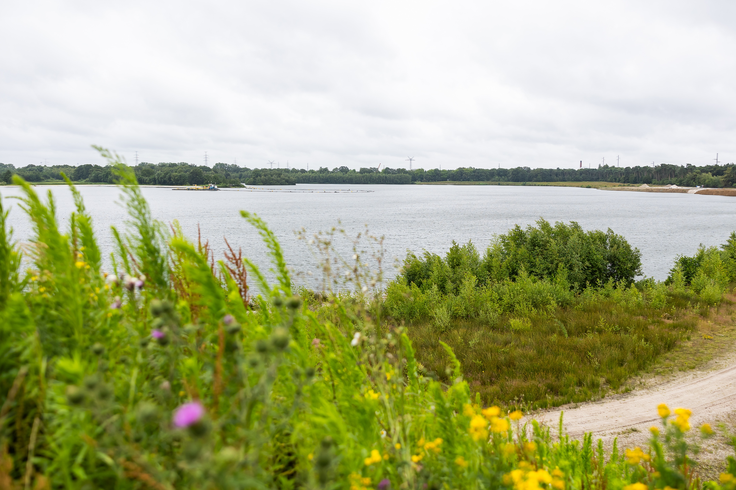
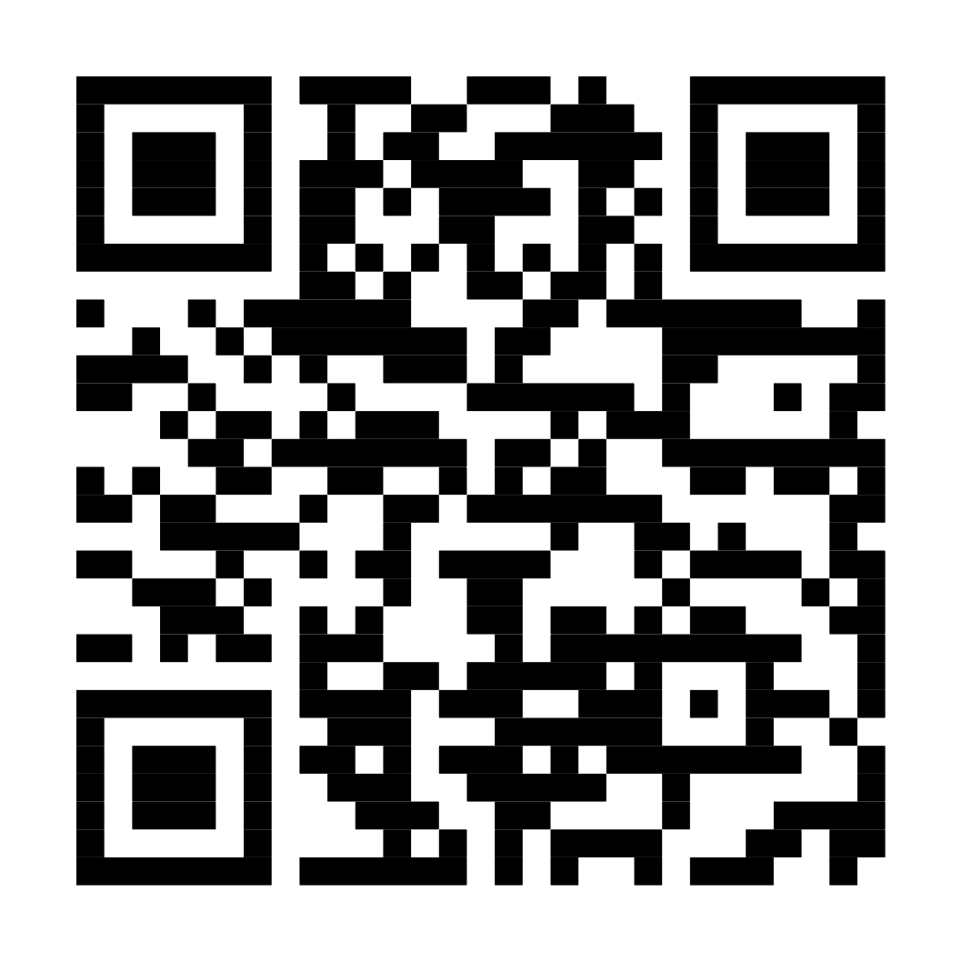
Sand quarries as strategic water buffers
Smart buffering to securing regional water supply for irrigation and drinking water.
“Monitoring network enables data driven decision making and resilience.”
Read more

Slide 13
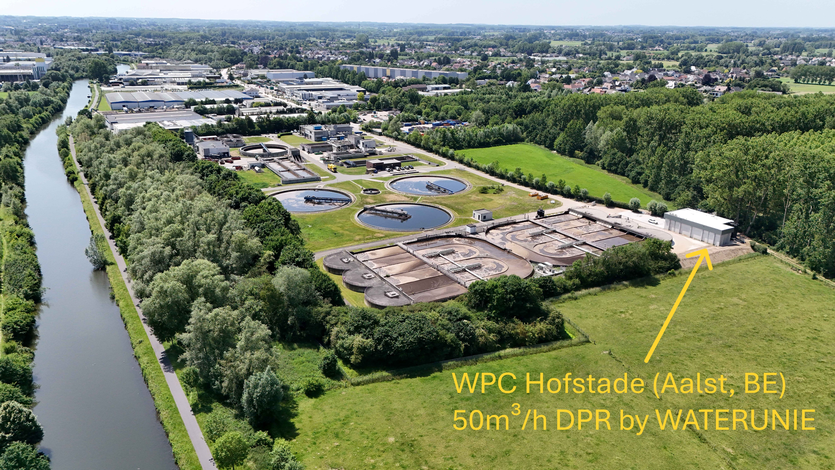
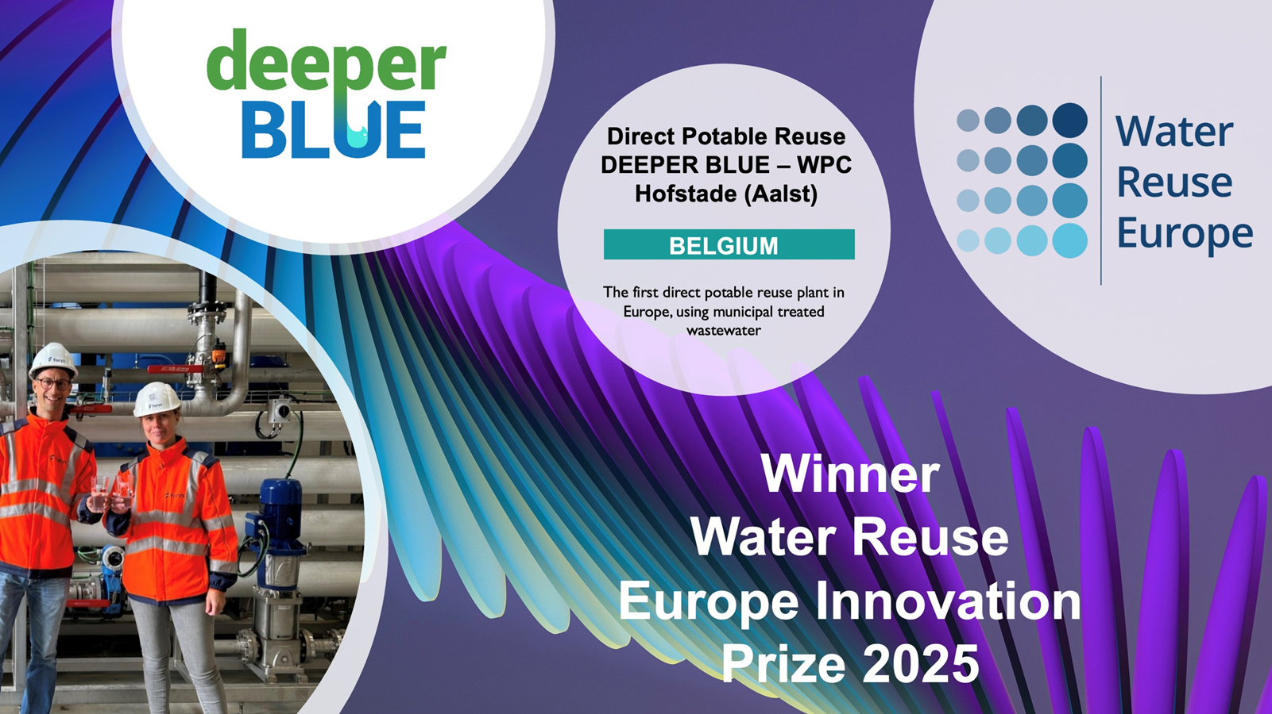
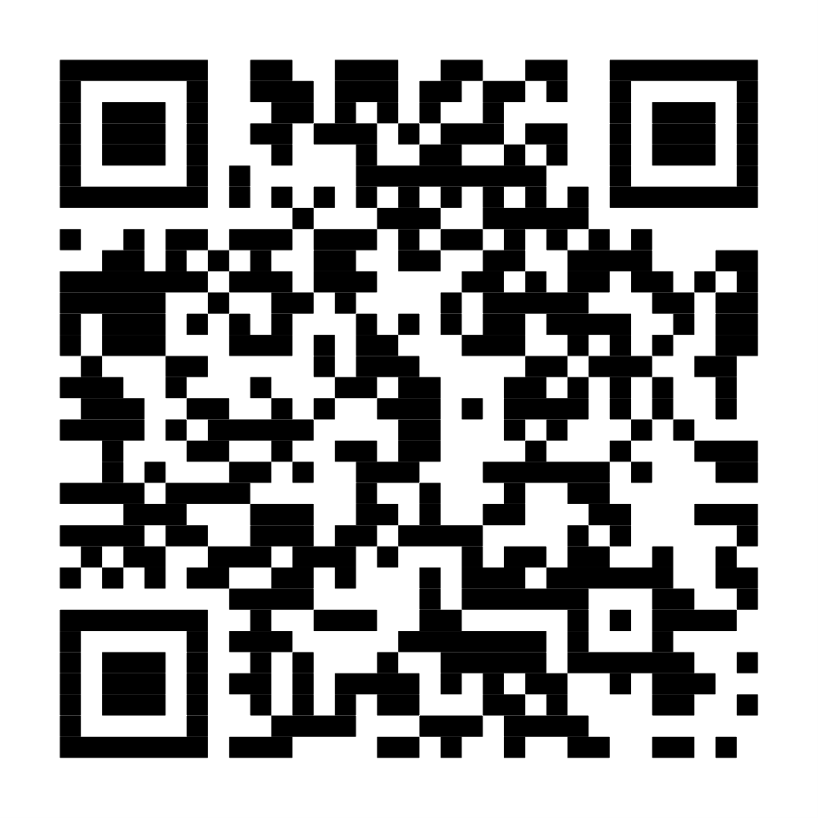
Direct potable reuse
The first direct potable reuse plant in Europe, using treated municipal wastewater.
“Storing water is easy -delivering it when it truly matters is resilience”
©Waterunie
Read more

Slide 14
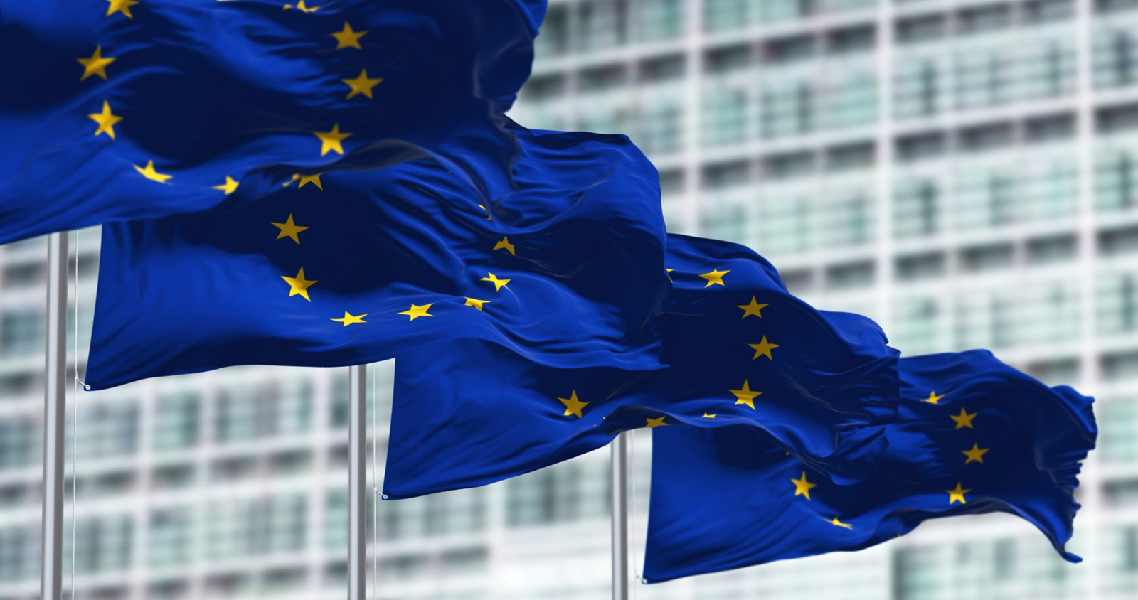
From regional to global
Flanders’ Blue Deal inspires
Flanders’ systemic approach
Integrated, adaptive, and stakeholder-driven is a replicable model for other EU regions.
Our fluid way of working
Collaboration, innovation, and solution-oriented thinking turns strategic visions into concrete, effective actions.
Notes:
Deze voorbeelden tonen de breedte en diepte van Vlaanderens expertise en innovatie in waterbeheer, wat de regio tot een ideale partner maakt voor wie op zoek is naar duurzame en effectieve wateroplossingen.
Vandaag is water voor Vlaanderen zowel een onmisbaar goed als een bron van zorgen. En daarmee brengt het vele bedrijven, organisaties en overheden samen uit alle domeinen van de economie en samenleving. Die stakeholders varen sinds 2022 in internationale wateren onder eenzelfde vlag. In Fluid Crew bundelen we onze krachten en zetten we samen Vlaanderen als waterregio op de kaart.

Slide 15

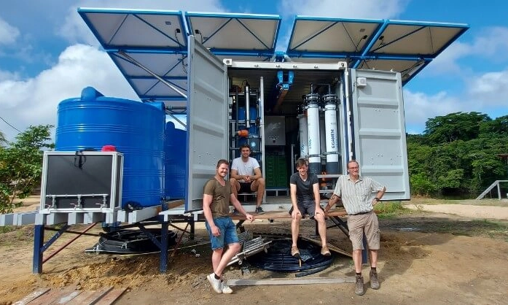
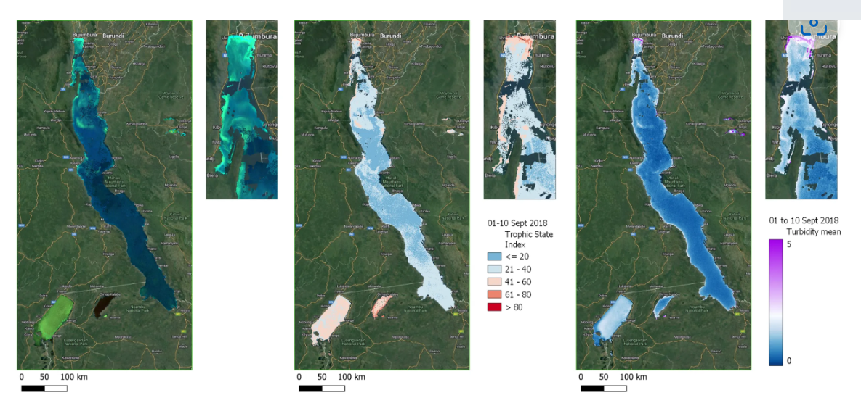
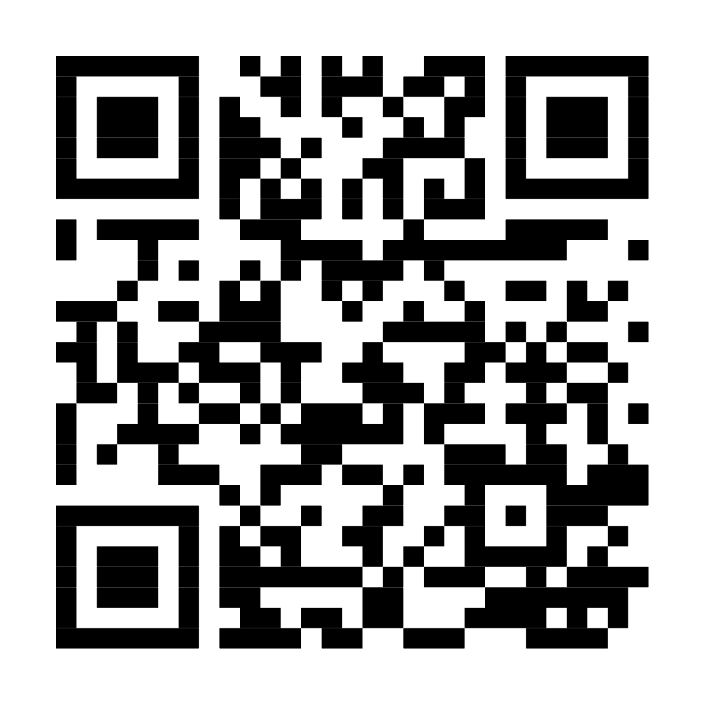
From regional to global
Suriname & Moldova
Decentralised solution – water/energy
Read more
Lake Tanganyika - Africa
Ecosystem services – water quality monitoring

Slide 16

One drop
can’t move
a stone...
But 7(00) million can

Slide 17
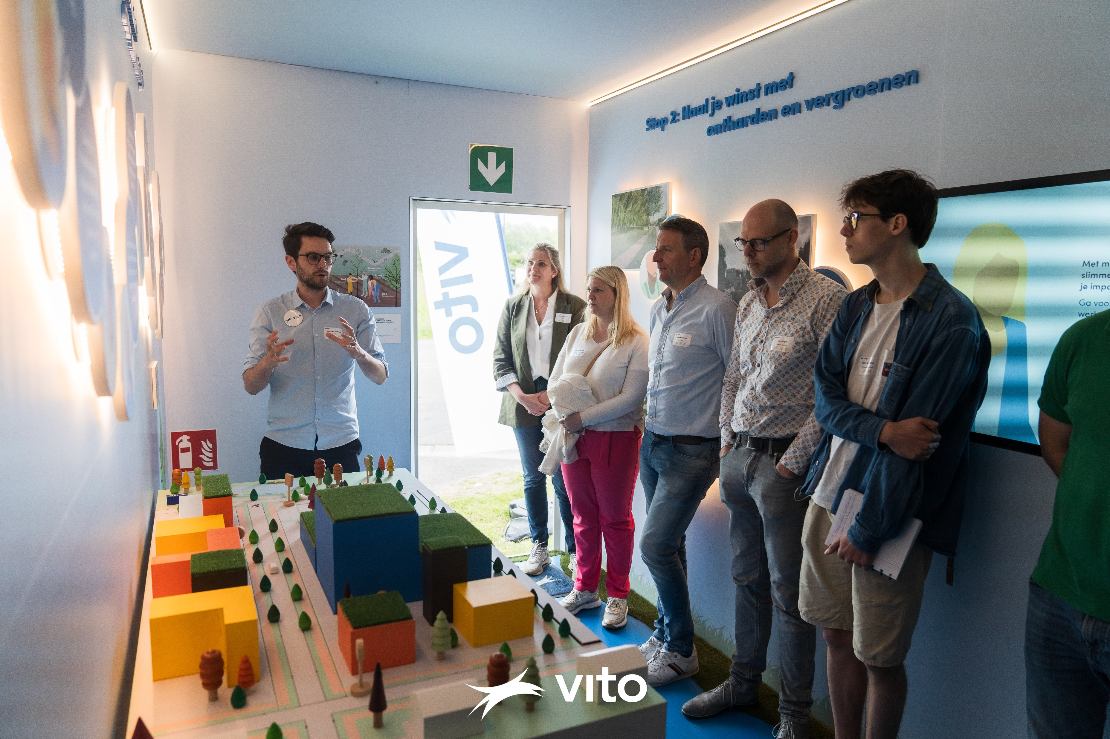
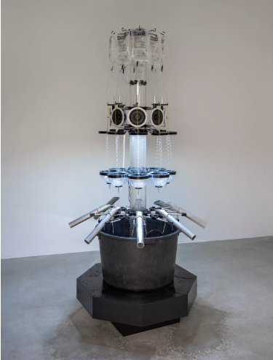
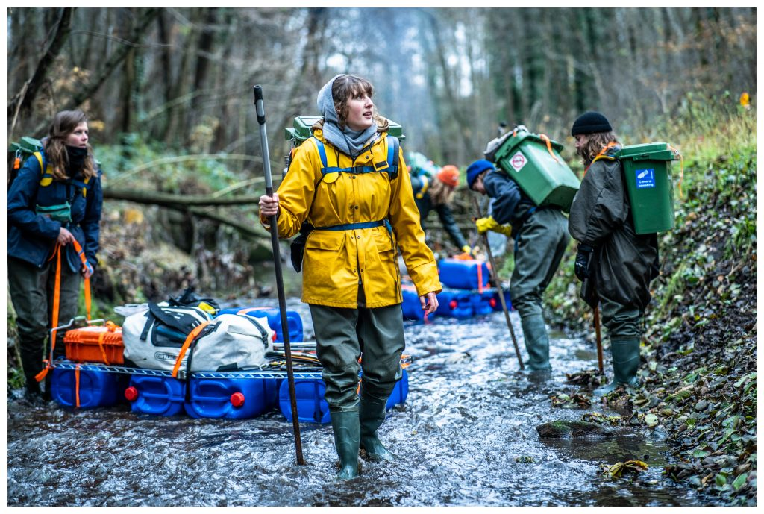
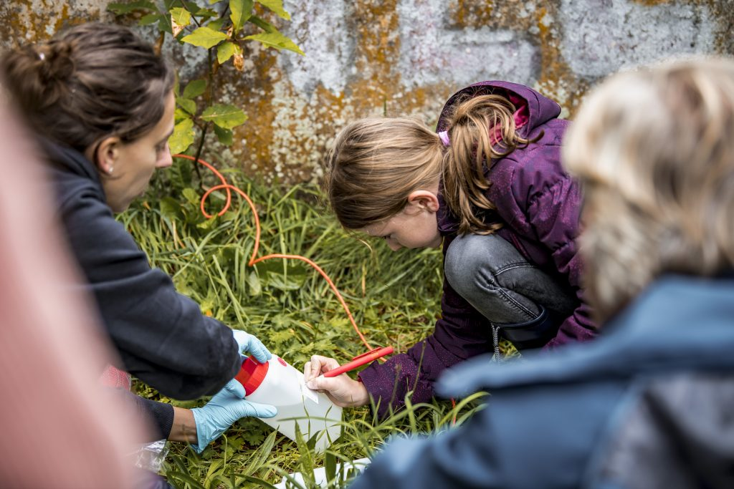
People are at the heart of Flanders’ fluid approach
Water experience container - © VITO
River clean up - © Simon Verschelde
S+T+ARTS4water - Artist: Haseeb Ahmed
Stiemerlab - © Boumediene Belbachir

Slide 18
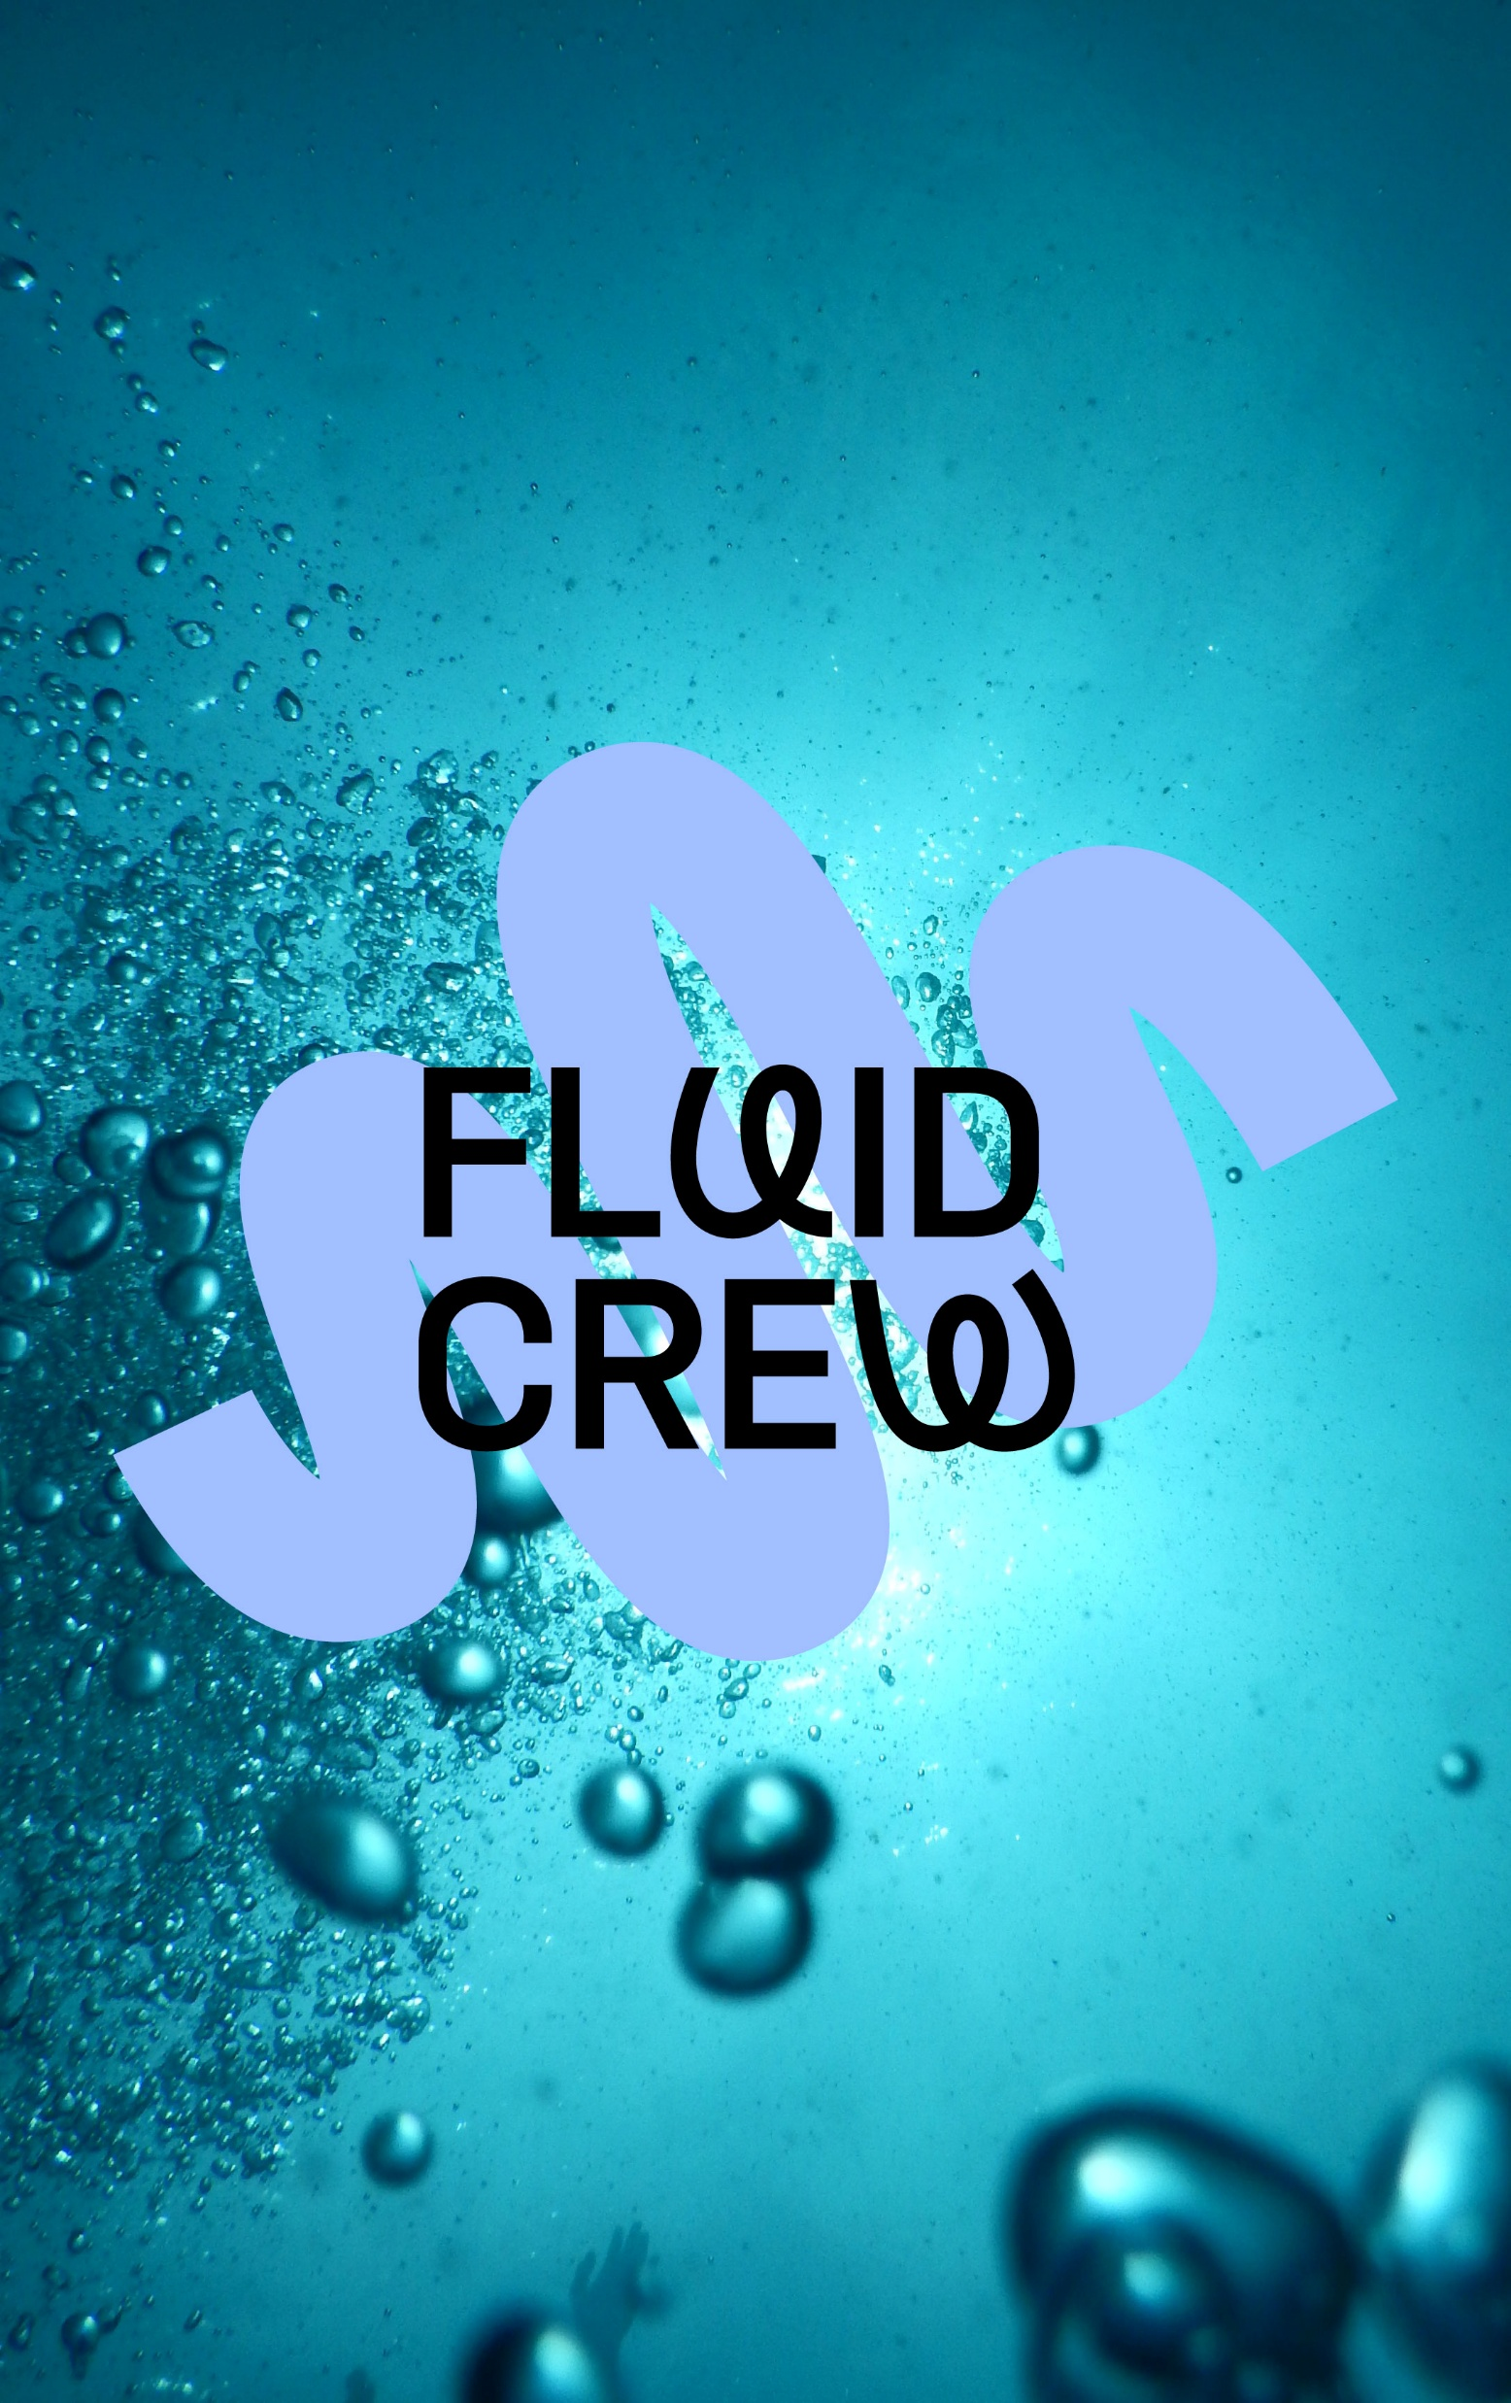
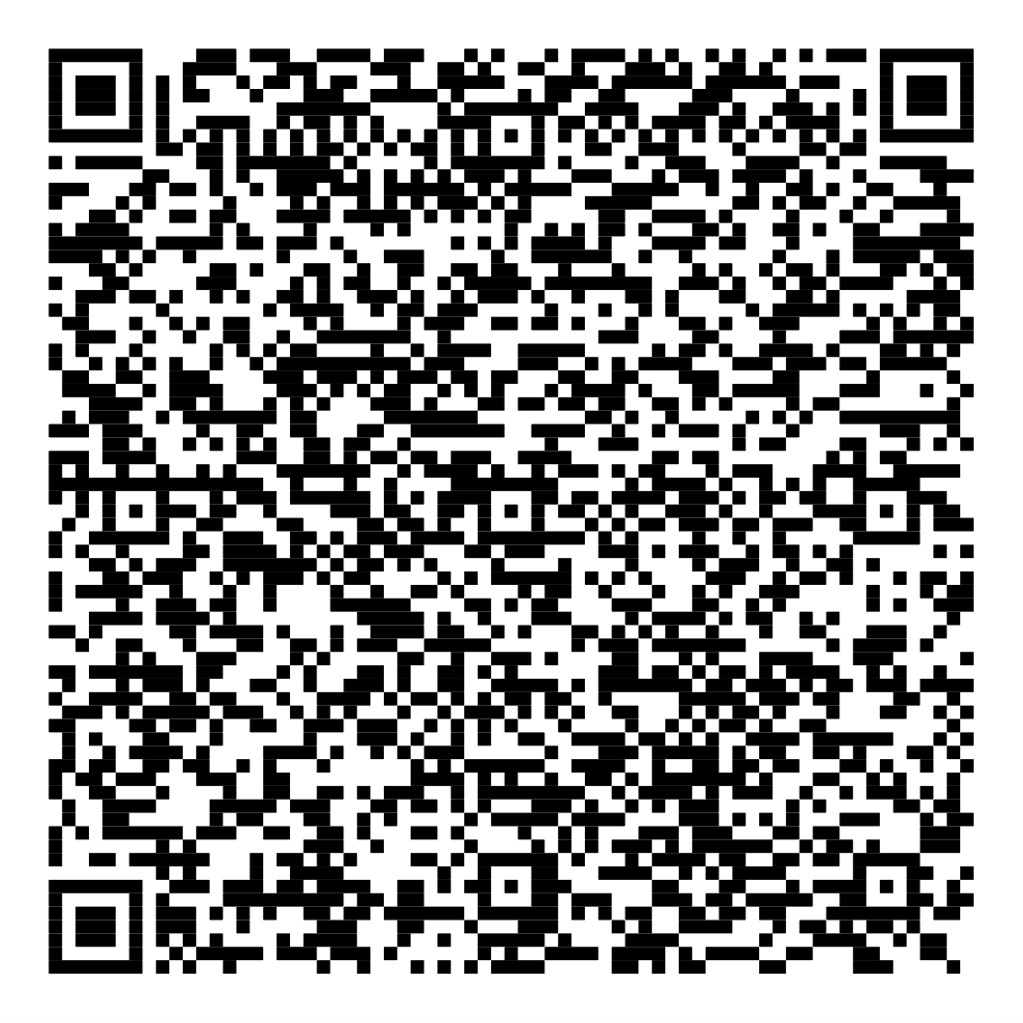
Get in touch with Flanders’ Fluid Crew
hello@fluidcrew.be

